Slide 1
How do I work with this learning material?
Power Point
Multimodal transports are presented in the following slides. The slides are briefly described in the corresponding notes. If further information is needed, the sources used are mentioned as well.
Reader
Additionally a reader is provided which describes the topic more in detail. It can be used as a script.
Links
The sources used for the presentation are provided in the learning packages as a bibliography.
Videos
Additionally there are videos available for use during the training. They are integrated into the relevant learning packages.

Slide 2
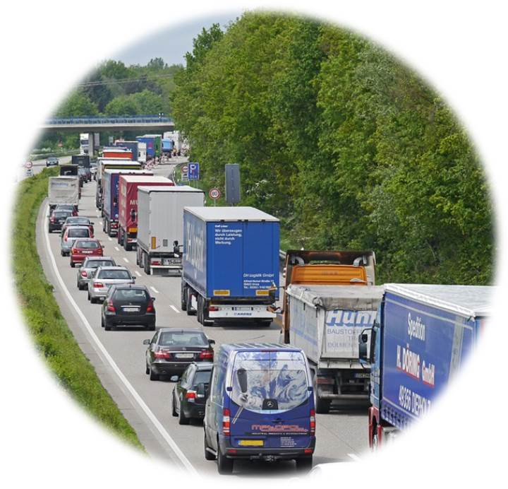
Warm-Up: Discussion
CO2
Increasing Freight Transport
Particulate matter
Noise
Source: https://pixabay.com/de/autobahn-stau-baustellenstau-pkw-1338440/
Notes:
A discussion can serve as access to the topic „multimodal transport“.
Global freight traffic is increasing - any product can be ordered. This leads to congestion in transport infrastructure. Road transport in particular is increasingly reaching its limits, which is expressed in increasing congestion. Environmental pollution is also rapidly growing: increasing CO2 emissions, particulate matter and noise pollution.
Discussion questions (5-10 minutes discussion):
Which possibilities exist to solve the problem in freight transport?
How could freight transport be shaped in the future?
Possible discussion points:
Transport concepts
Alternative means of transport
Future infrastructure requirements

Slide 3
MULTIMODAL TRANSPORT
Contribution to Sustainable Freight Transport
Notes:
This set of slides deals with multimodal transport, i.e. the transport of goods by several means of transport. The different types are described and their advantages and disadvantages are illustrated with practical examples.

Slide 4
Agenda Multimodal transport as a contribution to sustainable freight transport
Advantages and challenges
Perspective
Multimodal transport chain
Multimodal transport in Europe
Application example

Slide 5
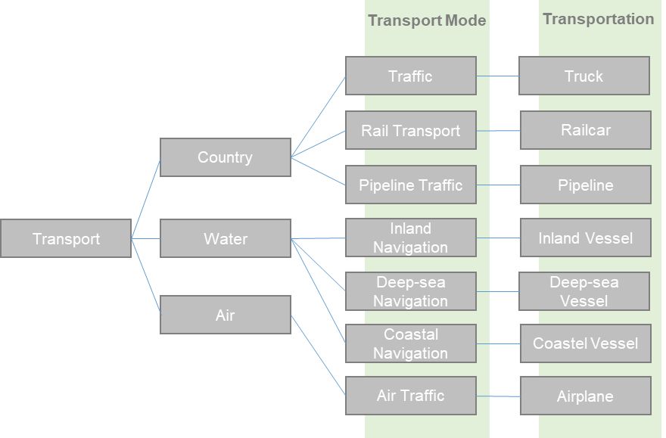
Definitions
Means of transport: vehicle used for the transport of passengers and goods (e.g. inland waterway, truck, …)
Transport mode: Infrastructure used by the means of transport (such as road, rail, waterway,…)
Source: viadonau based on Gronalt et al.2010
Notes:
There are different types of transport mode and means of transport. A transport mode provides the infrastructure required for the use of a particular means of transport. Road, rail and inland waterways are transport modes.
Means of transport are vehicles and equipment for transporting people and goods such as inland waterways, trucks or trains.
Source:
Via donau, „Handbuch der Donauschifffahrt“, S. 176-178

Slide 6
Overview of Transport Processes
Transport processes
Multi-unit transport
Single-tier
Multi-unit unimodal transport
Multimodal transport
Single-tier unimodal* transport
Modal split
Intermodal transport
Direct transport (direct shipping)
Broken bulk transport
General cargo transport
Combined transport (rolling road, UCT)
Further intermodal transport
*Unimodal = Goods are transported from their source to their destination by a means of transport
Notes:
As the above graphic demonstrates, there exist a large number of transport processes. In a single-tier transport process, the source (shipping point) and destination (receiving point) are connected without changing a means of transport or a transport mode. This is also referred to as unimodal transport.
In a multi-unit transport process, there is either a change between means of transport or a change between transport modes and a transhipment process takes place.
Multi-unit unimodal transport: In case of multi-unit unimodal transport, the goods are transported by several means of transport, but the transport mode stays the same (e.g. goods are first transported by an articulated truck and loaded onto small trucks in the course of transhipment).
Multimodal transport: At least two transport modes are used for multimodal transport.
Modal split: If goods are themselves trannshiped during transport, we call this as modal split. This also includes broken bulk transport (e.g. pellets) and general cargo transport (e.g. parcel shipping).
Intermodal transport: When goods are transported in the same loading unit (e.g. container) and when the loading unit (not the transported goods) is transshipped, we call it an intermodal transport. If the major part of the transport route within Europe is covered by rail or inland waterway, this is referred to as combined transport. Looking at the combined transport, we further distinguish between accompanied combined transport (e.g. rolling road) and unaccompanied combined transport (UCT).
Source:
Posset et al., „Intermodaler Verkehr Europa“ (2014), S. 32-40

Slide 7
Elements of Multimodal Transport
Stuffing (loading the loading unit)
Pre-haulage
Transhipment
Main-haulage
End-haulage
Stripping (unloading the loading unit)
Transportation route
Transportation route
Notes:
Basically, the multimodal transport chain consists of the elements pre-haulage, transhipment, main-haulage and end-haulage. In some cases, stuffing and stripping - the loading and unloading of the loading unit (e.g. container) - can also be considered as elements of the multimodal transport chain.
Source:
Posset et al., „Intermodaler Verkehr Europa“ (2014), p. 51-55

Slide 8
Transportation Routes Elements of multimodal transport
Pre-haulage
First segment of a transportation path: Consignor → shipping hub
Mainly with truck
Main-haulage
Shipping hub → receiving hub
End-haulage
Receiving hub → Consignee
„Last-Mile“
Mainly with truck
Notes:
A specific transportation path is covered for pre-, main- and end-haulage.
The pre-haulage is the first segment of the transportation and takes place from the consignor to the first hub. Consolidated transport can also serve as pre-haulage, if several consignments from different consignors are collected in a hub. The goods are then transported to the main-haulage, from the shipping hub to the receiving hub. The goods are finally transported from the receiving hub to the consignee. The end-haulage is often also called the "last mile" and is of particular importance in transportation matters. Pre-and end-haulage are mainly organized with trucks, as the access to terminals and thus to rail and inland waterways is rather limited.
Source: Posset et al., „Intermodaler Verkehr Europa“ (2014), p. 52-54

Slide 9
Container Loading and Unloading Elements of multimodal transport
Stuffing (loading)
Criteria:
Space-saving, damage prevention
Weight and distribution in the container – maximum weight country specific for rail and road)
Stowage plan – optimal capacity utilization, efficient design of loading and unloading
Packaging – load securing, labelling of goods
CTU-Code (Cargo-Transport-Unit): Code of practice
Stripping (unloading)
Often provided as an additional service if goods from different shippers are located in one container (e.g. consolidated container)
Notes:
During container loading (stuffing), the goods must be stowed in a space-saving manner. Furthermore the risk of damage has to be minimised. Other important criteria when loading a container are the maximum weight (varies for rail and road depending on the country) and the distribution of this weight in the container. In addition, an optimal stowage plan guarantees an efficient as well as safe container. loading and unloading. The packaging of goods is also needed in order to secure the load and to label the goods which are located in the container. The CTU-Code is a non-mandatory global code of practice for handling and packing shipping containers for transportation by sea and land.
CTU Code: https://www.unece.org/trans/wp24/guidelinespackingctus/intro.html
An optimal loading of the container also allows an optimally designed stripping procedure. Often the container unloading is provided as an additional service, for instance when goods from different consignors are transported together in one container.
Source:
Posset et al., „Intermodaler Verkehr Europa“ (2014), p.51, 54

Slide 10
Transhipment Elements of multimodal transport
Mode switching: change of unit/load between the transport modes
Necessity of terminals and transhipment facilities
Vertical and horizontal transhipment
Vertical transhipment → classic handling: loading unit is lifted with the aid of equipment such as crane; tested over many years
Horizontal transhipment → loading unit is not lifted, terminal infrastructure could be needed but not necessarily, e.g. transhipment truck on the train („Rolling road“)
Notes:
In order to make the change of transport mode (mode switching) possible, the loading unit (e.g. container) has to be transhipped. Terminals and transhipment facilities are usually required so that the transhipment can be handled.
Depending on the type of transhipment equiment, a distinction is made between vertical and horizontal transhipment. Vertical transhipment is the classic type of transhpment in which the loading unit is lifted with the aid of cranes or any other equipment and loaded from one transport mode to another. This type of transhipment has been tested for many years. This is why a lot of equipment is available as regards this type of transhipment. During a horizontal transhipment the loading unit is not lifted. This means that a terminal infrastructure is not necessarily required. An example for horizontal transhipment is the transhipment of a truck onto a train („Rolling road“).
Source:
Posset et al., „Intermodaler Verkehr Europa“ (2014), p.52/53

Slide 11
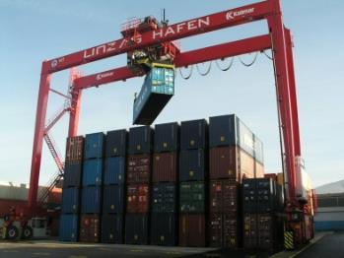
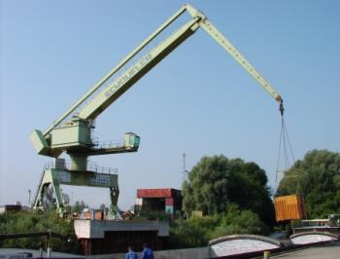
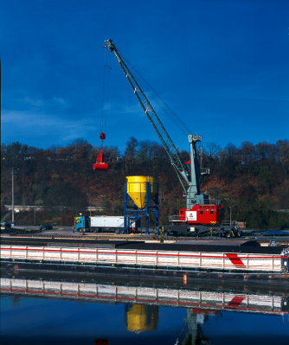
Transhipment Facilities Elements of multimodal transport
Bridge or gantry crane
Transhipment on containers
around 25 containers/hour
Luffing jib crane
Universal handling crane
For hooked and gripping goods
Mobile crane
Movable in the harbour area
Often slower than special cranes
Source: Linz AG
Source: Schaufler Ybbs
Source: Hafen Passau
Notes:
The use or the purchase of cranes for special terminals highly depends on the type of the transhipped goods.
Bridge or gantry cranes are mainly used for the transhipment of containers. It is also possible to use them for other goods such as sheets and tubes. The transhipment capacity is about 25 containers per hour.
A luffing jib crane is a universal transhipment crane which can be ideally used for hooked and gripping goods. Aquisition costs are much higher than those for a bridge crane.
Mobile cranes can be used as initial equipment for ports, they support existing crane systems.
Soucre:
viadonau, „Handbuch der Donauschifffahrt“, p.84-85

Slide 12
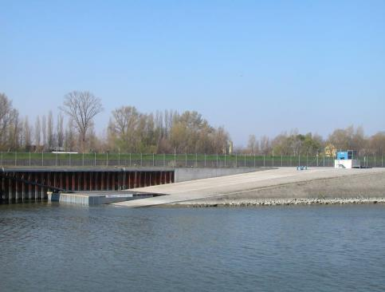
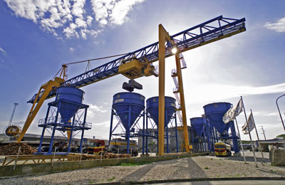
Transhipment facilities Elements of multimodal transport
RoRo-Ramps (Roll-on-Roll-off)
Transhipment of rolling units (e.g. passenger cars)
Cars and trucks directly drive („roll“) onto the ship
Loading hopper
Transhipment of bulk cargo
The bulk cargo (e.g. gravel or fertilizer) can be more
quickly transhipped onto the ship via a funnel.
Possible to store the goods in the funnel until arrival of the ship
Source: Hafen Freudenau
Source: Mierka Donauhafen Krems
Notes:
The transhipment of the rolling units such as passenger cars requires the installation of so-called roll-on roll-off ramps. Numerous Danube ports are equipped with such kinds of ramps.
Loading hoppers are used for the transhipment of bulk cargo from inland waterway navigation onto rail or truck. As the inland waterway navigation contains a much higher quantity as a single truck trailer or a rail wagon is able to hold, loading hoppers are needed. Those loading hoppers decouple the process of transhipment. The crane fills the loading hopper from above with the bulk cargo while the truck or the rail car are loaded below. This filling happens independently. Those loading hoppers are intermediately used as storage facilities.
Source:
viadonau, „Handbuch der Donauschifffahrt“ (2013), p. 85-86

Slide 13
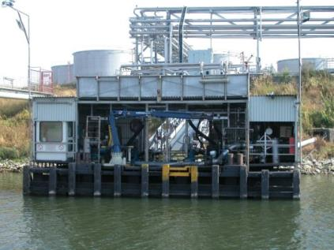
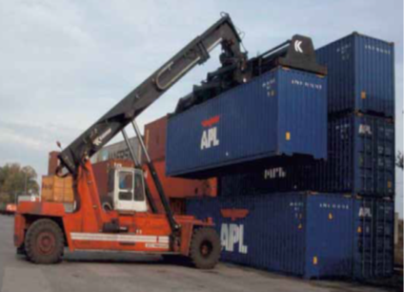
Transhipment facilities Elements of multimodal transport
Suction and pumping devices
Transhipment of liquid cargo
Reach Stacker
Wheeled vehicles, supplementing cranes
Maximum load capacity of 45 tonnes
Source: Hafen Lobau
Source: Liebherr-Werk Nenzing
Notes:
Special suction and pumping devices are required for the transhipment of liquid goods. These devices, so-called filling stands, are docked to the tanker by means of a swing-out arm and the goods are pumped into storage facilities or directly into waiting trucks or railcars. Apart from that tanks can be filled directly from storage. As the majority of the transhipped liquid goods belong to dangerous goods, these transhipmend facilities have high safety requirements.
A reach stacker is a wheeled vehicle which containers can be transhipped with. Such vehicles are usually used to supplement cranes or bridge cranes. A reach stacker differs from a stacker in the way that the former can not only move vertically upwards, but by means of an extendable lifting arm also forwards in the direction of the container. That is why container stacks with a height of 4 to 6 containers can be served. The maximum carrying capacity of the reach stacker is up to 45 tons, though it naturally decreases with the height of the stacks.
Source:
viadonau, „Handbuch der Donauschifffahrt“ (2013), S. 87

Slide 14
Actors in multimodal transport
Shipper
Consignee
Freight Forwarder
Kombi-Operator
Carrier A
Terminal A
Train/
Inland Waterway
Terminal B
Carrier B
Flow of goods
Flow of information
Notes:
The illustration above shows the actors who are involved in the multi-modal transport process.
Shipper: The shipper – also known as the consignor/sender – hands over the goods to the freight forwarder or carrier, who is responsible for delivery to the consignee. The shipper can organize the transport himself or commission an intermediary (forwarder or combi-operator) to organize the transport. A freight contract is concluded in this case. The actual consignor of the goods can be the shipper himself, the freight forwarder or combination operator or the consignee of the goods ("collection order"). The original shipper is the owner/proprietor of the transported goods.
Freight forwarder: The freight forwarder serves as an intermediary on behalf of the shipper and organizes the transport with the carrier or provides other services. The freight forwarder's tasks include concluding the contract of carriage, organizing freight documents, completing customs formalities and inspecting the goods and documents at the place of destination. He is also entitled to reimbursement of actual expenses and commission.
Carrier: The carrier is specifically responsible for the transport of goods and carries it out himself or has it performed by others. Unlike the freight forwarder, who mainly organizes the transports, the carrier makes the means of transport available for the transport
Combi-operator: The combi-operator or multimodal carrier concludes a multimodal contract of carriage and, as the carrier, is responsible for its performance. They often offer transport routes to the most important centres in Europe, especially in the area of maritime and continental traffic. The customer first submits a transport request to the combined transport operator, who then finds the best and cheapest connection for the customer's loading unit. The combined transport operator organizes either the transport from terminal to terminal (pre-carriage and onward carriage must be organized by the customer himself) or the entire transport chain.
Consignee: The consignee is entitled to accept the goods. By means of the freight contract, the consignee may request the carrier to hand over the goods at the place of delivery and instruct him accordingly. However, the consignee may also act as the principal if he concludes a forwarding contract with the freight forwarder.
Shippers, freight forwarder, carrier, combi-operator and consignees are natural as well as legal persons.
Source:
Posset et al., „Intermodaler Verkehr Europa“ (2014), S.63

Slide 15
Agenda Multimodal transport as a contribution to sustainable freight transport
Advantages and challenges
Perspective
Multimodal transport chain
Multimodal transport in Europe
Application example

Slide 16
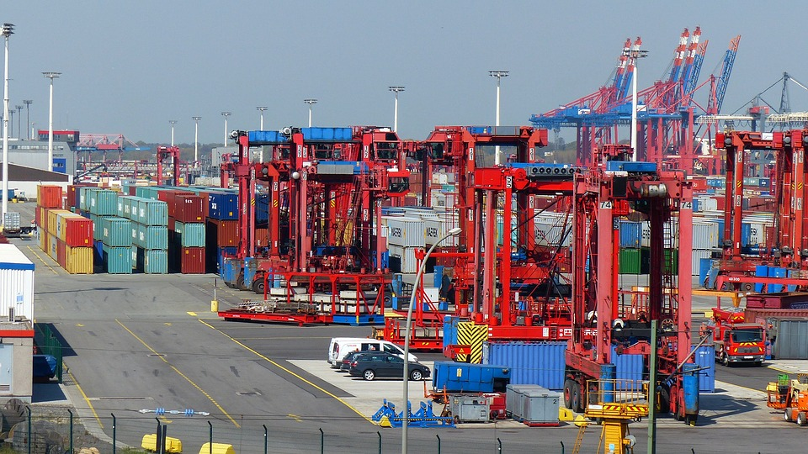
Advantages of multimodal transport
Environmental factors
Energy efficiency
Geographical situation
Truck capacities
More economical, if…
Transhipment is efficiently designed
Pre- and end-haulage are cost-effective
A bundling in main-haulage is possible
Additional services
Source: https://pixabay.com/de/container-lifter-container-hafen-1367609/
Notes:
Due to serveral reasons multimodal transport can be more advantageous than unimodal transport.
Many transports, for example, cannot be carried out in an unimodally way because of geographical reasons or there is not enough truck capacity available. In practice, the most important reason for selecting a particular transport option is the economic aspect, of course - which transport alternative is the most cost-effective?
The organization of a multimodal transport is naturally many times more complex due to the many actors involved and the handling processes required and requires increased planning effort. It is therefore often difficult to guarantee cost-effectiveness in comparison to truck transport and is often only necessary for longer transports. Thus, multimodal transport is usually not competitive on short distances.
The following factors are therefore essential for the economic design of multimodal transport.
Efficient design of transhipment processes
Cost reduction regarding pre- and end-haulage
Bundling in main-haulage in order to compensate for additional costs
To offer additional services
Source:
Posset et al., „Intermodaler Verkehr Europa“ (2014), p.48

Slide 17
Strenghts and weaknesses of transport modes
Specific advantages of utilisation of transport modes
Minimise disadvantages of transport modes
Transport mode | Strenghts | Weaknesses
Road | High network density Speed regarding short transport distances | Low transport volumes High external costs
Rail | Low environmental impact (CO2, pollutant, noise) More dense rail network (in comparison to waterway) Low-cost and fast on medium haul routes | Lower rail network density than the road
Waterway | Low transport costs and low negative effects at high volumes Safety and security | Transport duration (low transport speed) Low waterway network density
Notes:
By combining modes of transport, the specific advantages of each mode of transport can be exploited and their disadvantages minimised. Due to the high network density and the speed with short transport routes, road is particularly suitable for the pre- and post-carriage of multimodal transports. Due to the low environmental impact and the relatively low transport costs of rail and waterway with medium or long transport route and high volumes, these two modes of transport are suitable for the main run in multimodal transport. By bundling freight transports, appropriate transport volumes can be achieved which justify the transport with these modes of transport from an economic point of view.
BMVIT, Rechnungshof; „Bericht des Rechnungshof: Nachhaltiger Güterverkehr – Intermodale Vernetzung” (2012), S.260
Online: http://www.rechnungshof.gv.at/fileadmin/downloads/2012/berichte/teilberichte/bund/Bund_2012_05/Bund_2012_05_4.pdf

Slide 18
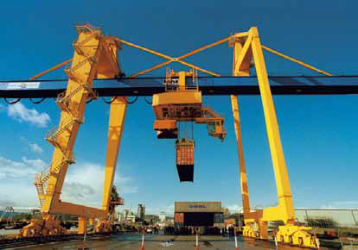
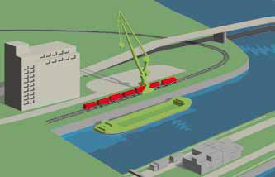
Requirements for multimodal transport
Source: Mierka Donauhafen Krems
Transported goods
Features & benefits
Transport volume
Infrastructure
Acess to means of transport and transport modes
Terminals
Transhipment process
Storage
Additional services
Source: viadonau
Notes:
Multimodal transport is not always an optimal solution. Diver conditions must be met, so that multimodal transport can be considered as an option. The goods must be suitable for transport in loading units. Furthermore an appropriate transport volume should be available as well. Especially bulk cargo or high and heavy general cargo is suitable for multimodal transport.
In addition, an appropriate infrastructure must be in place which enables multimodal transport. Access to various means of transport and transport modes are particularly important. Terminals also play an important role in multimodal transport. They enable transhipment processes between transport modes, serve as warehouses for asynchronous delivery and collection and offer additional services if required. These include, for example, repair, maintenance or cleaning of leading units or stuffing or stripping of containers.
Source:
Posset et al., „Intermodaler Verkehr Europa“ (2014), p.56, 194,202

Slide 19
Challenges of multimodal transport
Transport organisation – collection, transhipment, delivery
Different actors / transport modes – coordination effort
Transhipment processes – Infrastructure
Transportation time
Costs / prices
Safety / security
Notes:
Since several actors and transport modes are involved in multimodal transport, transport has to be organised in an efficient way and with higher organisational efforts. In addition, appropriate loading facilities and thus infrastructure must be available in order to realise multimodal transport and access to various transport modes must be available. An important factor is the duration of transport, which can be extended by transhipment processes and also requires appropriate coordination of collection, transhipment and delivery.
The use of different transport modes and transhipment processes can lead to additional costs that may not be competitive with unimodal transport. Additionally, security is an important issue, as cargo transhipment processes are more likely to damage cargo or cause delays.
Source:
Posset et al., „Intermodaler Verkehr Europa“ (2014), p.56

Slide 20
Agenda Multimodal transport as a contribution to sustainable freight transport
Advantages and challenges
Perspective
Multimodal transport chain
Multimodal transport in Europe
Application example

Slide 21
Transport Policy: Freight Transport in Europe
2050:
+ 57 % transport volume
+ 55 % increase of truck transport
International freight traffic is increasing → transport distances are increasing
Bottlenecks in transport infrastructure
Rising energy costs
Public and political pressure → Need for an environmentally friendly transport solution
Source: Eurostat (2016)
*Percentage split of the respective transport mode in relation to the total freight transport volume
Notes:
As the 2014 Modal Split in Europe shows, a large part (76%) of freight transport is organised by truck. By 2050, an additional 55 % increase in truck transport is forecasted, with a 57% volume overall transport increase. Above all, international freight traffic will increase and so will the transport routes. In addition, the transport infrastructure is increasingly reaching its limits - congestion is the result. In addition, rising energy costs and increasing pressure from the public and political sectors lead to the fact that sustainable transport solutions have to be found.
Sources:
Eurostat, „Freight transport statistics – modal split“, (2016), Online: http://ec.europa.eu/eurostat/statistics-explained/index.php/Freight_transport_statistics_-_modal_split [25.07.2016]
European Commission, “EU energy, transport and GHG emissions - Trends to 2050 Reference Scenario 2013” (2013), S.39
Online: http://ec.europa.eu/transport/media/publications/doc/trends-to-2050-update-2013.pdf
International Transport Forum/ OECD, “ITF Transport Outlook 2015”, (2015), S.28,75,76
Online: http://www.oecd-ilibrary.org/docserver/download/7414021e.pdf?expires=1457012730&id=id&accname=ocid56027859&checksum=F3F96F396835D30F46A01AD6921DC83C
Bretzke/Barkawi, „Nachhaltige Logistik: Antworten auf eine globale Herausforderung“ (2010), ab S.30

Slide 22
Importance of multimodal transport Multimodal transport in Europe
→ Road freight transport as a central transport and environmental problem
Trucks: 45 % of freight transport performance - 80 % of traffic related emissions
Goal of the European Union:
Shifting transports to rail and waterways
Approach:
Promotion of multimodal transport, in particular combined transport
Using the strenghts of transport modes
multimodal transport has the potential for up to 30 % energy and 90 % pollutant saving (compared to truck transport)
Notes:
As stated in the previous slide, road freight transport leads to a central transport and environmental problem. The truck is responsible for 45% of freight transport performance, but is responsible for 80% of all transport-related emissions and causes the highest CO2 emissions of all land transport modes. Accordingly, the transport sector has great potential for reducing emissions and, above all, CO2. The European Union has also taken up this approach and in its transport white paper, has laid down the cornerstones for the new regulations of European transport policy up to 2050. The main objective is to shift transport from road to rail and waterway. In particular, these transports which exceed a transport distance of 300 km are to be transferred to inland waterway vessels or trains.
Since infrastructure bottlenecks make it difficult to shift transports to rail and waterways in isolation, it makes sense to intelligently combine the respective transport modes and to make targeted use of their respective advantages by organising multimodal transports, in particular combined transports.
As an illustration: In comparison to pure truck transport, multimodal transport has the potential to save up to 30% energy and as much as 90% of pollutants. In addition, the already overcrowded road network is relieved and traffic safety increased.
Source:
Posset et al., „Intermodaler Verkehr Europa“ (2014), p.15-17
European Commission, “White Paper on transport – Roadmap to a single European transport area – towards a competitive and resource-efficient transport system” (2011), p.4-6,9
Online: http://ec.europa.eu/transport/themes/strategies/doc/2011_white_paper/white-paper-illustrated-brochure_en.pdf

Slide 23
Status quo Multimodal transport in Europe
Statistically difficult to measure
Annual growth rate: 5 %
Source: UIRR (2012)
Notes:
The share of multimodal transport in European freight transport is difficult to measure, as each transport mode is recorded separately by the national survey method. A transport from Hannover (Germany) to Bologna (Italy), which uses the „Rolling road“ between Regensburd and Trento, is recorded in Austria as rail transit in combined transport. In Germany, road transport and rail transport are recorded separately. In European Union statistics only road transport on the Italian side is recorded.
Eurostat, the statistical office of the Euopean Union, uses figures from the UIRR – the International Union for Road-Rail Combined Transport operators from 14 European Countries that organise combined transport. The UIRR data was also used for the presentation of the consignment development. Unaccompanied combined transport (UCT) includes the transport of containers (20 feet and above), swap bodies and semi-trailers which are loaded/unloaded on rail wagons. For the rolling road (accompanied combined transport), the transport of trucks/semi-trailers with special low-floor wagons is recorded.
In 1990, almost 1 million consignments were transported with the help of unaccompanied combined transport (UCT). In comparison, the volume of consignments of the „Rolling Road“ counted only 215,000 consignments. The „Rolling Road“ reached the transport record in 2000 with 460,000 consignments and UCT in 2011 (2.65 million consignments). The collapse of the „Rolling Road“ can be explained because of the accession of several states to the European Union. In 2012 both transports recorded a decline in the volume of consignments. All in all, combined transport with an average growth rate of approximately 5 % represents a dynamic segment in European freight transport.
Source:
Posset et al., „Intermodaler Verkehr Europa“ (2014), p.22/23

Slide 24
Multimodal transport in Austria Multimodal transport in Europe
→ Most used intermodal transport
Proportion of intermodal traffic to total traffic: 7 % (2009)
79% unaccompanied combined transport - UCT (container traffic)
21% Rolling Highway - RoLa (entire truck is transported by train)
UCT higher growth potential
Mainly modal shift between road and rail
Waterway in intermodal transport minor role
0.02% share of intermodal transport
UCT higher growth potential than RoLa
Lower network density than rail
Notes:
In Austria, the share of intermodal transport in total traffic (tkm) in 2009 was 7%. Much of this traffic has been provided in unaccompanied combined transport (UKV), which is also attributed to higher growth potential for the future. Between 2000 and 2009, the UCT increased by 85% while Rolling Highway (RoLa) share of freight traffic decreased by 24% in the same period. The change of mode of transport takes place mainly between the modes of transport road and rail - the inland waterway is of relatively low importance. The share of inland waterway vessels in intermodal transport in 2009 was only 0.02% in Austria. Among other things, this can be attributed to the lower network density of the waterway compared to the rail.
Source:
BMVIT, Rechnungshof; „Bericht des Rechnungshof: Nachhaltiger Güterverkehr – Intermodale Vernetzung” (2012), S.258-260
Online: http://www.rechnungshof.gv.at/fileadmin/downloads/2012/berichte/teilberichte/bund/Bund_2012_05/Bund_2012_05_4.pdf

Slide 25
Agenda Multimodal transport as a contribution to sustainable freight transport
Advantages and challenges
Perspective
Multimodal transport chain
Multimodal transport in Europe
Application example

Slide 26
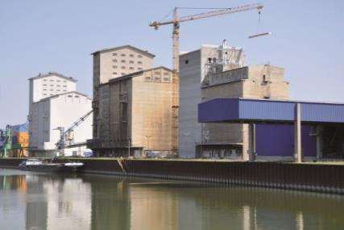
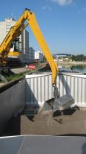
Application example Multimodal transport
Source: Hafen Wien, Bioprodukte Pinczker GmbH
Bulk cargo: Organic wheat
Modal split: Hungary – Vienna – Basel – Zurich
General cargo: Steel products
Split multimodal transport
Pre-haulage – Linz – Rotterdam– USA, Brazil, India– Consignee (end-haulage)
Bulk cargo: Mineral raw materials
Moisture-sensitive goods
Pre-haulage – Rotterdam – Linz – consignee (end-haulage)
© Hafen Linz (Linz AG)
Notes:
Bulk cargo: Organic wheat
The grain is transported by truck from the Pannonian region to the customer‘s own silo in the port of Vienna. After arriving there the intermediate storage is carried out in temperature-monitored cells. The cargo will then be loaded onto the inland waterway vessel within two days by means of conveyor systems. In order to make optimum use of the loading space, a swivel tube is used during the transhipment. The goods reach Auhafen in Basel via the Danube or Rhine. The grain is transported to the consignee (end customer) in Zurich by rail.
General cargo: Steel products
On the route from Linz to Moedijk (near Rotterdam) 500,00 tonnes of steel are transported annually by inland waterway. The steel products are transported by a wagon from various warehouses on the factory premises to the covered transhipment hall in the works harbour of the steel producer voestalpine Linz. There the goods are loaded directly from the wagons onto the inland waterway vessel. A bridge crane with a lifting capaity of up to 35 tonnes is used for transhipment in the Linz port hall. Afterwards the transport takes place by pushed train to Moerdijk. There the goods are transferred to a seagoing vessel and brought to the ports near the consignee (end customers). Latter are located in Brazil, the USA, Singapore, India and South Africa, for example. In most cases, the final transport takes place by rail, but trucks are also used in some cases.
Bulk cargo: Mineral raw materials
In the port of Linz, mineral raw materials are transported and transhipped. Due to sensitivity to moisture and contamination, transport is a difficult undertaking. At the beginning of the transport chain, the mineral raw materials are transported to Rotterdam by ocean-going vessels. The cargo is transferred to the inland waterway vessel, usually by means of a reach stacker or luffing jib crane. The raw materials are then transported from Rotterdam to Linz via the Rhine, Main and Main-Danube canals. This is usually done by motorized freighters or pushed trains, which can be loaded with an average of 1,000 tons per carrier. Depending on the end-customer, the cargo is transported to its final destination in the port of Linz by truck or rail.
Source:
Via donau, „Handbuch der Donauschifffahrt“ (2013), p. 184 ff

Slide 27
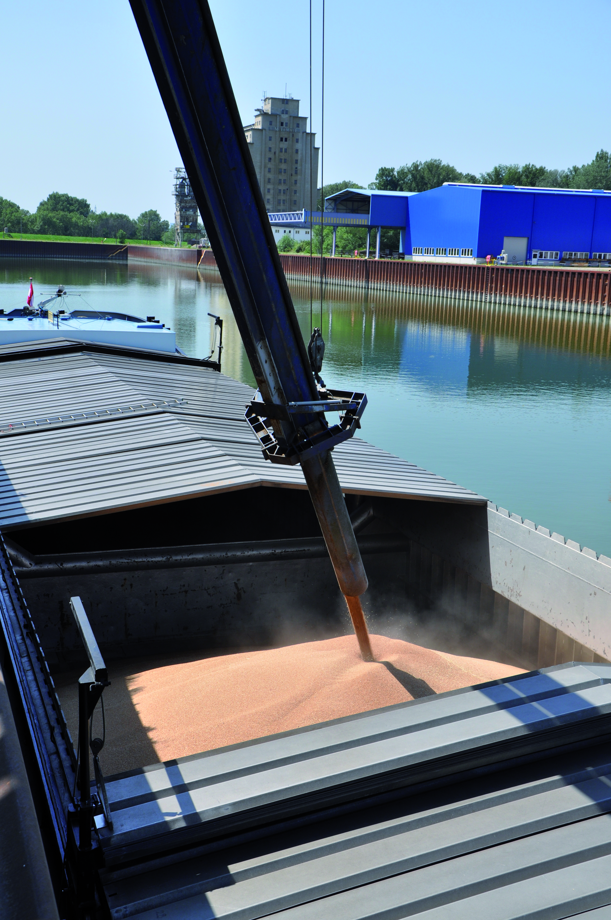
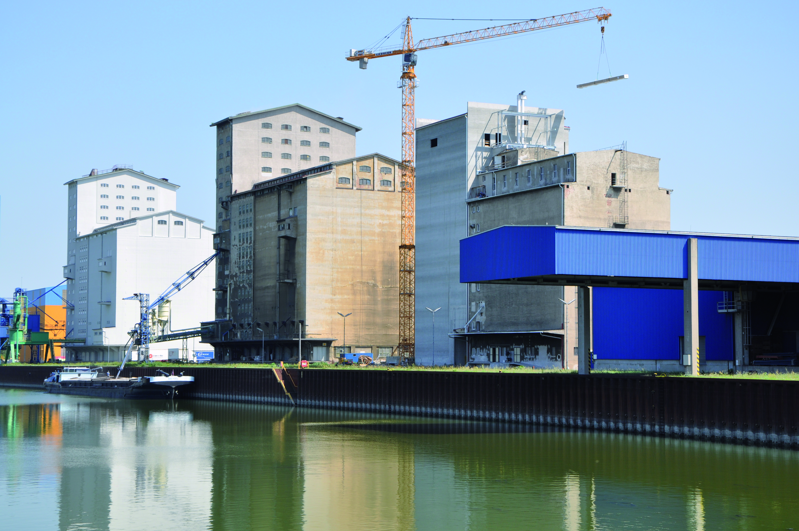
Example transport of organic wheat
Organic products Pinczker GmbH :
Organic wheat from Hungary to Vienna by truck
Temporary storage in silos
Loading onto the inland waterway vessel with a swivel tube
Via the Danube or Rhine to the port of Basel (9 days)
Transport to Zurich by rail
Source: Hafen Wien, Bioprodukte Pinczker GmbH
Source: Hafen Wien, Bioprodukte Pinczker GmbH
Notes:
The company Bioprodukte Pinczker GmbH is located at the port of Vienna Albern and owns and operates a grain silo there. Three transport modes, namely road, rail, and water, are used for the transport from Vienna to Zurich, with the majority of the Vienna-Zurich route being covered by inland waterway. The total transport time is 10 days.
Source:
viadonau, „Handbuch der Donauschifffahrt“ (2013), p.181-182

Slide 28
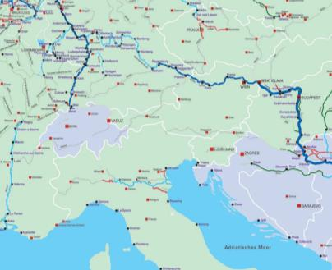
Example transport of organic wheat
Organic wheat: bulk cargo
Transport type: mode split
Truck: Hungary – Vienna
Inland vessel: Hungary – Basel
Train: Basel – Zurich
vessel
Zug
truck
Source: Hafen Wien, Bioprodukte Pinczker GmbH
Notes:
The grain is transported by truck from the Pannonian region to the customer‘s own silo in the port of Vienna. Arrived overthere, the intermediate storage is carried out in temperature-monitored cells. The cargo will then be loaded onto the inland waterway vessel within two days by means of conveyor systems. In order to make optimum use of the loading space, a swivel tube is used during the transhipment. The goods reach the Auhafen in Basel via the Danube or Rhine. The grain is transported to the consignee (end customer) in Zurich by rail.
Source:
viadonau, „Handbuch der Donauschifffahrt“ (2013), p. 181-182

Slide 29
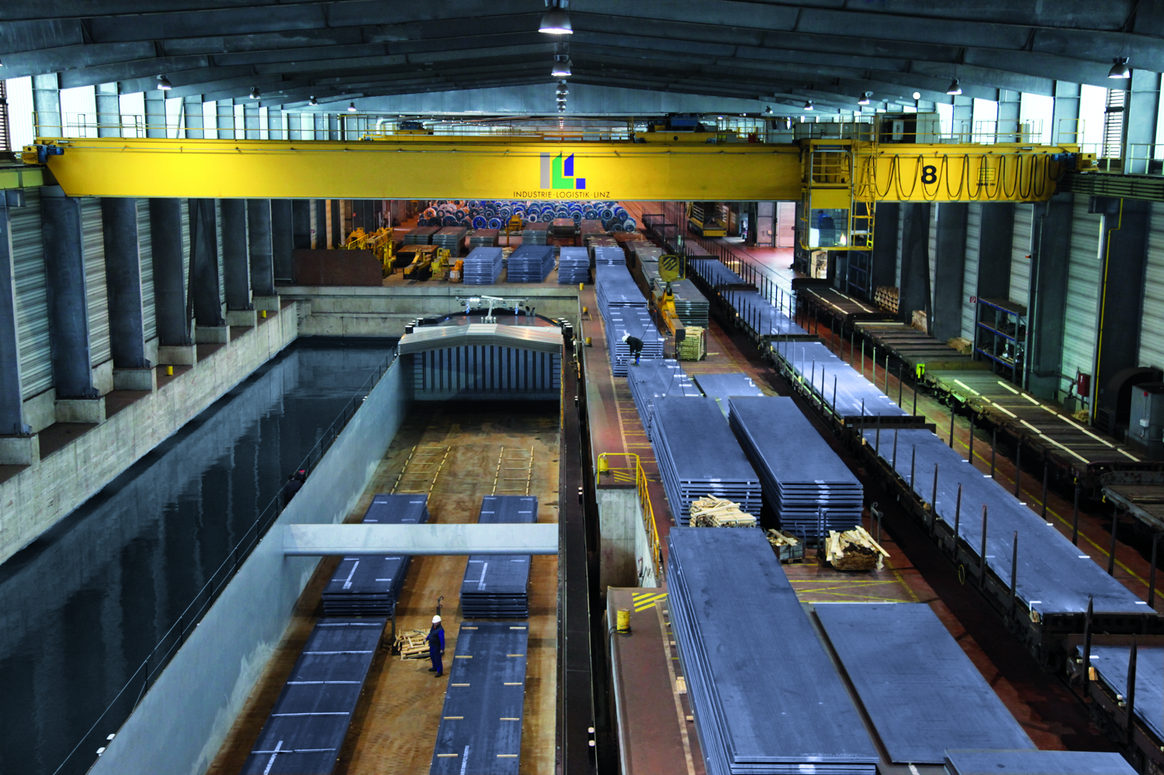
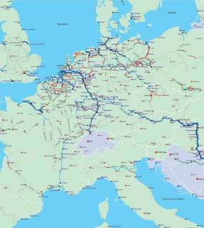
Example transport of steel products
voestalpine:
own plant harbour
Steel products (= general cargo) worldwide partly by vessel:
Transhipment in transhipment hall in Linz
Transport of 500,000 t steel/year to Moerdijk (near Rotterdam)
Transhipment on seagoing vessel
Destination: USA, Brazil, India,…
End-haulage via rail or truck
© ILL
Ocean-going vessel
Inland waterway vessel
Aug-19
Notes:
On the route from Linz to Moedijk (near Rotterdam) 500,00 tonnes of steel are transported annually by inland waterway. The steel products are transported by a wagon from various warehouses on the afactory premises to the covered transhipment hall in the works harbour of the steel producer voestalpine Linz. There the goods are loaded directly from the wagons onto the inland waterway vessel. An bridge crane with a lifting capaity of up to 35 tonnes is used for transhipment in the Linz port hall. Afterwards the transport takes place by pushed train to Moerdijk. There the goods are transferred to a seagoing vessel and brought to the ports near the consignee (end customers). Latter are located in Brazil, the USA, Sinapore, India and South Africa, for example. In most cases, the final transport takes place by rail, but trucks are also used in some cases.
Source:
Via donau, „Handbuch der Donauschifffahrt“ (2013), S. 185

Slide 30
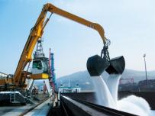
Example mineral raw materials
Port of Linz:
Mineral raw materials = bulk cargo
Very sensitive to moisture – transportation difficult
By means of seagoing vessel to Rotterdam
Transhipment by means of Luffing jib crane/reach stacker to inland waterway vessel
Over Rhein-Main-Danube-Canal (RMD) to Linz
By means of rail or truck to consignee
© Hafen Linz (Linz AG)
© Hafen Linz (Linz AG)
Notes:
In the port of Linz, mineral raw materials are transported and transhipped. Due to sensitivity to moisture and contamination, transport is a difficult undertaking. At the beginning of the transport chain, the mineral raw materials are transported to Rotterdam by ocean-going vessels. The cargo is transferred to the inland waterway vessel, usually by means of a reach stacker or luffing jib crane. The raw materials are then transported from Rotterdam to Linz via the Rhine, Main and Main-Danube canals. This is usually done by motorized freighters or pushed trains, which can be loaded with an average of 1,000 tons per carrier. Depending on the end-customer, the cargo is transported to its final destination in the port of Linz by truck or rail.
Source:
viadonau, „Handbuch der Donauschifffahrt“ (2013), p. 184

Slide 31
Agenda Multimodal transport as a contribution to sustainable freight transport
Advantages and challenges
Perspective
Multimodal transport chain
Multimodal transport in Europe
Application example

Slide 32
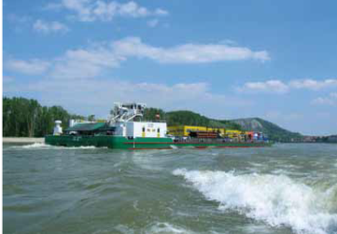
Promotion of multimodal transport
Source: via donau
European-Directive on the liberalisation of
pre- and post-haulage of combined transport
Increased attractiveness of combined transport:
Facilitation of international transport
Tax advantages (e.g. preferential container tax)
Financial grants
Further advantages: Exemption from night driving ban, weekend and holiday driving ban, etc…
Notes:
The use of combined transport is promoted by numerous transport policy measures. This is intended to ensure a shift to environmentally friendly transport modes, e.g. from truck to ship or rail. Measures to promote combined transport entail, in addition to various financial support measures that are possible at national and international level, tax and regulatory measures, such as an exempation from the ban on night driving or weekend and holiday bans.
The European Union has also taken important steps towards increasing the use of combined transport by adopting a directive on the establishment of common rules for certain types of combined transport between Member States. The aim of this Directive is to liberalise the pre- and post-carriage of combined transport, thereby increasing the attractiveness of its use. The most important points concern the facilitation of international transport. Tax relief is also provided for.
Source:
Via donau, „Handbuch der Donauschifffahrt“ (2013), p. 188-191

Slide 33
Promotion of multimodal transport
Further development of the European transport network
Liberalisation of rail freight transport
Increased capacity
Avoidance of traffic bottlenecks (rail and waterway)
Technical improvements
Standards for loading units
Notes:
A further development of the transport network in Europe, in particular from the environmentally friendly modes of transport rail and waterways, should encourage a modal shift towards these transport modes. In addition, increasing liberalisation of rail freight transport will enable competitive prices in rail transport. In order to increase the use of rail and waterways, capacities must be increased to make bundling more attractive and to avoid traffic bottlenecks.
A technical improvement to optimise transport planning and improve the performance of modes can also favour the use of multiodal transport. Appropriate standards must be defined for loading units so that they can be transported on different transport modes without any problems and the handling can be optimally designed.
Source:
Via donau, „Handbuch der Donauschifffahrt“ (2013), p. 188-191
Institute for Transport Studies, Universität Leeds, Vereinigtes Königreich; „Die Zukunft der Nachhaltigkeit in Güterverkehr und Logistik“ (2010), p. 22/23
Online: http://www.europarl.europa.eu/RegData/etudes/note/join/2010/431578/IPOL-TRAN_NT(2010)431578_DE.pdf

Slide 34
Megatrends in freight transport
Logistics
Safety and Security
Climate
change
Urbanisation
E-commerce
Digitalization
Mobile world
New transport concepts
Notes:
There are some megatrends that will influence logistics and hence freight transport in the future. These megatrends make new transport concepts necessary and support the development of new transport concepts.
Safety is alsways a decisive factor in the transport sector. Security checks at different points in the transport chain are becoming increasingly important. In addition, the various actors must ensure that the transport chain is not used for terrorist purposes. The consequences of climate change are becoming increasingly visible, making sustainable strategies necessary. Some measures have already been taken: Emission limits for means of transport such as trucks or increased use of alternative fuels such as liquefied natural gas (LNG), which is mainly used in inland navigation.
The increasing size of cities leads to infrastructure bottlenecks in conurbations and poses a major challenge for logistcs service providers. By bundling flows of goods outside the cities (in consolidation centres), the flows of goods to/from the cities can be optimally designed. E-commerce and thus the online trade has a decisive influence on the volume of transport, as the shipment of goods is a decisive service for the customer. Increasing digitalisation can, for example, minimise transport distances. With access to 3D printers, spare parts can be produced where the customer needs them, eliminating long hauls from the manufacturer.
Most means of transport are already equipped with technical interfaces, enabling communication between them. This creates a mobile world in which transports can be coordinated via smart phones, for example. For example, you can be notified on your mobile phone when a parcel is delivered and open the door for the parcel service.
Source:
Lehmacher W., „Wirtschaft, Gesellschaft und Logistik 2050 in Logistik – eine Industrie, die (sich) bewegt. Strategien und Lösungen entlang der Supply Chain 4.0“ (2015), p. 9-15

Slide 35
Multimodal transport concept in the future
Intermodality
Transport with at least two transport modes
Only the loading unit (not the goods themselves) is handled (e.g. container transport)
Co-modality
Optimal use of the various transport modes
Promotes the use of alternative means of transport
Synchromodality
Combination of intermodality and co-modality
Efficient and cooperative use of idfferent transport modes
Avoidance of unimodal transports
Real-time switching between transport modes
Notes:
Intermodal transport can be classified as a special form of multimodal transport. At least two transport modes are used, whereby only the loading unit (e.g. container) is handled and not the goods themeselve. This makes the transhipment even more efficient and allows cost savings to be achieved. The risk of damage to the goods is also lower.
A modal shift from road to other modes of transport is increasingly supported by politicians. The concept of co-modality meets this requirement, as it aims to raise awareness of sustainable freight transport and thereby achieve optimum use of the various transport modes.
The concept of synchromodality combines the concepts of intermodality and co-modality. Through an efficient and cooperative use of the various transport modes, the existing transport infrastructure should be optimally used. The exchange of real-time data makes it possible to switch beteen transport modes in real time. This is to avid unimodal transport – if possible and reasonable.
Source:
viadonau, „Handbuch der Donauschifffahrt“ (2013), p.175
Results Internal Report „SynChain“ (2015) – for more information regarding this source kindly contact us.
Dominic Stead, „Mid-term review of the European Commission‘s 2001 Transport White Paper“ (2006), p. 367, Online: http://www.ejtir.tudelft.nl/issues/2006_04/pdf/2006_04_04.pdf
Europe Container Terminals BV, „The future of freight transport – ECT‘s vision on sustainable and reliable European transport“ (2011), Slide 5-11, Online: http://www.informatie.binnenvaart.nl/documenten/doc_view/158-the-future-of-freight-transport-ect-s-vision-on-sustainable-and-reliable-european-transport [26.07.2016]

Slide 36
Bibliography
Via donau, „Handbuch der Donauschifffahrt“ (2013), Download: http://www.viadonau.org/de/newsroom/publikationen/handbuch-der-donauschifffahrt/
Posset et al., „Intermodaler Verkehr Europa“ (2014)
BMVIT, Court of Audit; „Bericht des Rechnungshof: Nachhaltiger Güterverkehr – Intermodale Vernetzung” (2012),Online: http://www.rechnungshof.gv.at/fileadmin/downloads/2012/berichte/teilberichte/bund/Bund_2012_05/Bund_2012_05_4.pdf [26.07.2016]
Eurostat, „Freight transport statistics – modal split“, (2016), Online: http://ec.europa.eu/eurostat/statistics-explained/index.php/Freight_transport_statistics_-_modal_split [26.07.2016]
European Commission, “EU energy, transport and GHG emissions - Trends to 2050 Reference Scenario 2013” (2013), Online: http://ec.europa.eu/transport/media/publications/doc/trends-to-2050-update-2013.pdf [26.07.2016]
International Transport Forum/ OECD, “ITF Transport Outlook 2015”, (2015), Online: http://www.oecd-ilibrary.org/docserver/download/7414021e.pdf?expires=1457012730&id=id&accname=ocid56027859&checksum=F3F96F396835D30F46A01AD6921DC83C [26.07.2016]
European Commission, “White Paper on transport – Roadmap to a single European transport area – towards a competitive and resource-efficient transport system” (2011), Online: http://ec.europa.eu/transport/themes/strategies/doc/2011_white_paper/white-paper-illustrated-brochure_en.pdf [26.07.2016]
Institute for Transport Studies, University Leeds, United Kingdom; „Die Zukunft der Nachhaltigkeit in Güterverkehr und Logistik“ (2010), Online: http://www.europarl.europa.eu/RegData/etudes/note/join/2010/431578/IPOL-TRAN_NT(2010)431578_DE.pdf [26.07.2016]
Results Internal Report „SynChain“ (2015) – for more information regarding this source kindly contact us.
Dominic Stead, „Mid-term review of the European Commission‘s 2001 Transport White Paper“ (2006), Online: http://www.ejtir.tudelft.nl/issues/2006_04/pdf/2006_04_04.pdf [26.07.2016]
Europe Container Terminals BV, „The future of freight transport – ECT‘s vision on sustainable and reliable European transport“ (2011), Online: http://www.informatie.binnenvaart.nl/documenten/doc_view/158-the-future-of-freight-transport-ect-s-vision-on-sustainable-and-reliable-european-transport [26.07.2016]
Lehmacher W., „Wirtschaft, Gesellschaft und Logistik 2050 in Logistik – eine Industrie, die (sich) bewegt. Strategien und Lösungen entlang der Supply Chain 4.0“ (2015)

Slide 37
Additional Information
We hope our slide set meets your requirements!
- Your are welcome to adapt the slide set according to your wishes and requirements and use it for your lessons/lectures.
For questions and feedback please contact our research team.
alexandra.haller@fh-steyr.at or lisa-maria.putz@fh-steyr.at are at your disposal.
You can find further slide sets here:
http://www.reecotrans.at/en/teaching-materials/bundles/
If you are interested in our Transport School Lab or a guest lecture have a look at:
http://www.reecotrans.at/en/services/

