Slide 1
How do I work with this learning material?
Power Point
The topic transport and environment is presented in the following PowerPoint. In the corresponding notes the slides are briefly described an the sources used for them are listed if futher information is needed.
Reader
In addition to the PowerPoint presentations, a reader is provided that describes the topic in more detail and can be used as a script.
Links
The sources used for the presentation are provided in the learning packages under a link collection.
Videos
Additionally there are videos available which can be used. They can also be found in the relevant learning packages.

Slide 2
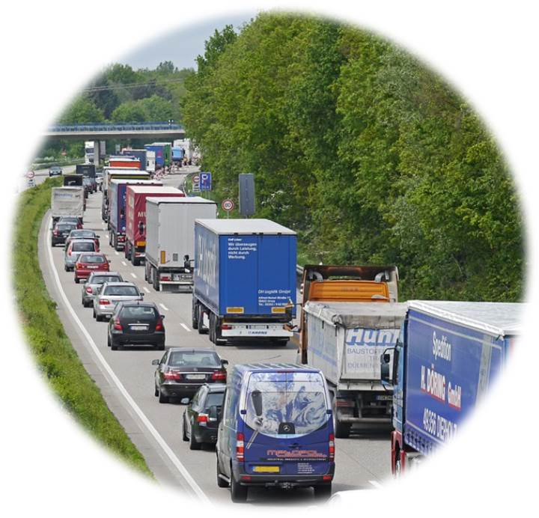
Warm-Up: Diskussion
CO2
Particulate matter
Din
Source: https://pixabay.com/de/autobahn-stau-baustellenstau-pkw-1338440/
Notes:
A discussion could serve as an introduction to the topic of „Transport and Environment“
The global freight traffic is increasing more and more – meanwhile it is possible to buy every product online o in a shop. Thanks to express deliveries, products are „justa mouse click away“. This leads to a congestion of the transport infrastructure.
Road transport in particular is increasingly reaching ist limits, which is reflected in increasing congestion. Environmental pollution is also increasing: Increasing CO2 emissions, fine dust pollution and noise pollution.
Discussion questions (5-10 minutes discussion):
Which influence does consumer behaviour have on freight transport?
Which contribution can an individual make in order to reduce freight traffic?
Input- possible discussion points:
Society significantly influences freight transport
Recessions reading when shopping online, this could avoid returns
No weekling shopping by car

Slide 3
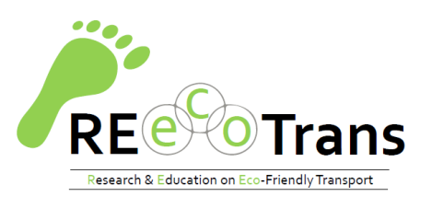
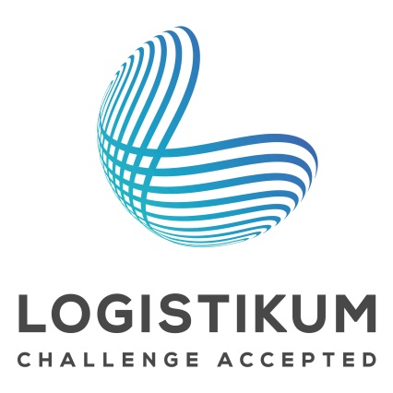
Traffic and Environment
and which contribution every individual can make

Slide 4
Agenda Traffic and the environment and the contribution every individual can make
Traffic and Environment
Comparison of Transport Modes
Influencing Factor Society
Sustainable Transport Modes
Challenges for Sustainable Freight Transport

Slide 5
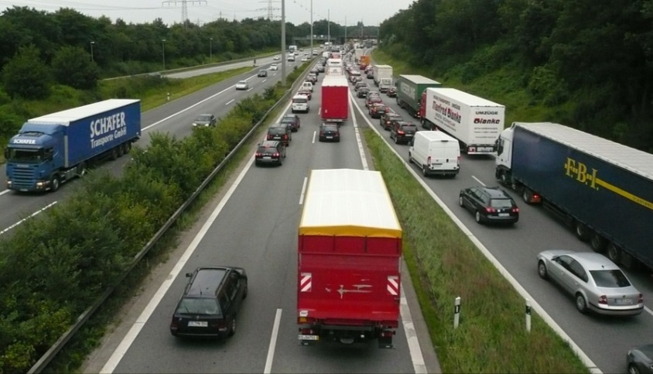
Traffic and Environment
Status Quo:
Freight transport = most polluting area in logistics
Most visible to society → noise, congestion, air pollution and environmental pollution are associated primarily with trucks
Perspective:
International freight traffic is increasing → increasing transport distances
Until 2050:
+ 57 % transport volume
+ 55 % increase in truck transporte
Source: https://pixabay.com/de/autobahn-pkw-lkw-verkehr-stau-171006/
2050
2016
Notes:
Logistics plays an essential role in the economy as it ensures that the goods are transported from the raw material supplier via the producer to the end consumer. Although logistics encompasses many processes and activities, transport, and thus freight transport, can be identified as the most polluting sector.
An additional 50% increase in truck transport is forecasted for 2050, with the total transport volume also rising by 57%. Above all, international freight traffic will increase and so will the transport routes. In addition, the transport infrastructure is increasingly reaching ist limits – congestion is the result.
Sources:
Consent Markt- und Sozialforschung: Imageanalyse FRIENDS on the road (2014), S. 6 Online: https://www.wko.at/Content.Node/iv/presse/wkoe_presse/presseaussendungen/Studie__FriendsOnTheRoad_Transpoteure_pwk_116_022014.pdf [09.08.2016]
Whiteing A. : „Die Zukunft der Nachhaltigkeit in
Güterverkehr und Logistik“ (2010), 9.7
Online: http://www.europarl.europa.eu/RegData/etudes/note/join/2010/431578/IPOL-TRAN_NT(2010)431578_DE.pdf [26.07.2016]
European Commission, “EU energy, transport and GHG emissions - Trends to 2050 Reference Scenario 2013” (2013), p.39
Online: http://ec.europa.eu/transport/media/publications/doc/trends-to-2050-update-2013.pdf [09.08.2016]
International Transport Forum/ OECD, “ITF Transport Outlook 2015”, (2015), p.28,75,76
Online: http://www.oecd-ilibrary.org/docserver/download/7414021e.pdf?expires=1457012730&id=id&accname=ocid56027859&checksum=F3F96F396835D30F46A01AD6921DC83C [09.08.2016]

Slide 6
Traffic and Environment
23 % of global CO2 emissionens trace back to transport (2005) → 30 % in OECD Ländern
Source: UBA (2012)
Source: Eurostat (2016)
Notes:
At the global level, transport was responsible for 23% of CO2 emissions in 2005, and 30% across all OECD countries. At the European level, the transport sector is also the second largest emitter of greenhouse gases after fuel combustion (23,2 % of greenhouse gases). As the 2010 cmomparison of greenhouse gas emissions at the transport mode level in Germany shows, trucks in particular are responsible for a large proportion of greenhousse gases (over 50%), followed by inland waterway vessels with a share of 22%.
Sources:
Eurostat, „Greenhouse gas emission statistics“, (2016), Online: http://ec.europa.eu/eurostat/statistics-explained/index.php/Greenhouse_gas_emission_statistics [05.08.2016]
Federal Environment Agency (UBA), “Daten zum Verkehr – Ausgabe 2012” (2012), p.14
Online: https://www.Federal Environment Agency.de/sites/default/files/medien/publikation/long/4364.pdf [04.08.2016]
International Transport Forum, “Reducing Transport Greenhouse Gas Emissions. Trends & Data 2010.”, (2010), p.7
Online: http://www.itf-oecd.org/sites/default/files/docs/10ghgtrends.pdf [05.08.2016]

Slide 7
Drivers for sustainable development
Increase in energy costs
Dependence on oil
Increase in transport volume
Infrastructure bottlenecks
Increase in transport volume
Traffic jam
Political pressure
Taxes, internalisation of external costs, emission limits
Public printing
Lower tolerance for reduced mobility and environmental pollution
Special influence on transport industry
Source :INRIX (2014)
Notes:
According to Bretzke & Barkawi, four drivers of sustainable ddevelopment can be identified: The increase in energy costs due to the dependence in oil and the increase in transport volumes. The latter leads to increasing traffic congestion. This results in a bottleneck in the transport infrastructure. The third and fourth driver is the increasing political and public pressure, which is expressed by taxes, an increasing consideration of external costs as well as the specification of emission limits for means of transport. In addition, society has an increased interest in environmentally friendly transport solutions without having to restrict ist own mobility. The transport industry is mainly influenced by social trends, due to ist proximity to the economy and private shippers.
The areas of influence mentioned above mainly affect truck transport, which means that sustainable transport modes such as rail or waterways are increasingly being pushed.
Sources:
Bretzke, Wolf-Rüdiger/Karmin Barkawi: Nachhaltige Logistik: Antworten auf eine globale Herausforderung. Berlin Heidelberg, 2010, p.33ff
Kudla, Nicole: Nachhaltigkeitsmanagement, in: Fagagnini Hans Peter/Stöltzle Wolfgang (Hrsg.): Güterverkehr kompakt, 2010, p.232
Image source - URL: http://inrix.com/press/scorecard-report-united-kingdom/ [04.08.2016]

Slide 8
Drivers for sustainable development - European Commission White Paper 2011
Oil dependence
Increasing transport volume
Greenhouse gases
Multimodality*/ modal shift
Increasing demand for sustainable transport modes
* Freight transport using two or more transport modes
Targets for modal shift
2030: 30 % of road traffic > 300 km of rail/inland waterway
2050: 50 % vom Straßenverkehr >300 km of rail/inland waterway
→ Rail & inland waterways are recognised as sustainable transport modes!
Notes:
As described in the previous slide, a change to sustainable transport modes is necessary. This is why European policy tries to promote a change to such transport modes by means of various measures. The European Commission‘s 2011 White Paper „Roadmap to a Single European Transport Area – Towards a competitive and resource-efficient transport system“ presented the EU‘s vision for transport in the future. This White Paper contains proposals for action by the EU to make transport more sustainable in the future. As rail and inland waterways are recognised as sustainable transport modes, there should also be a modal shift towards them. The objective by 2030 is to shift 30% of road transport over 300 km to rails or inland waterways. By 2050, the value should be 50%.
Source:
Europäische Komission, “Weissbuch - Fahrplan zu einem einheitlichen europäischen Verkehrsraum – Hin zu einem wettbewerbsorientierten und ressourcenschonenden Verkehrssystem” (2011), p. 3ff
Online: http://eur-lex.europa.eu/legal-content/de/TXT/PDF/?uri=CELEX:52011DC0144 [05.08.2016]

Slide 9
Sustainable transport
Sustainable production
Sustainable products
Sustainable transport
(green logistics)
(Freight)transport is essential, in order to connect raw material suppliers with producers and end consumers.
„Green logistics is a logistics concept, that demands logistcs to be environmentally friendly, socially responsible and financially viable.“ Rituray Saroha (2014)
Notes:
Since a large number of producers are increasingly designing their production to be sustainable and end consumers are demanding more and more sustainable products (especially in the food sector), there is also an increasing need for sustainable transport. An important logistics concept in this context is „green logistics“. As it appears in the description, in addition to the environmental and social friendliness of the transport modes, the financial aspect is also very important. Since transport is essential to connect all actors along the value chain (from raw material supplier via producer to consumer), the latter can be identified as one of the most important elements of logistics. It is therefore important to first measure the impact of the transport sector from an ecological, social and economic point of view and then define appropriate measures to reduce.
Sources:
„Synchromodality“ (2013), Online: https://www.youtube.com/watch?v=5ofhMxRRyec [03.08.2016]
Saroha Rituraj, “Green Logistics & its Significance in Modern Day Systems” (2014), p.90
Transportation Research Board of the National Academies, “The Value of Freight: Introduction to the Role of Freight Transportation” (2011), Online: http://www.envisionfreight.com/value/index.html%3Fid=introduction.html [03.08.2016]
Kudla, Nicole: Nachhaltigkeitsmanagement, in: Fagagnini Hans Peter/Stöltzle Wolfgang (Hrsg.): Güterverkehr kompakt, München, 2010, p.232

Slide 10
Green logistics Targets
Expenses
Unproductiveness
Green logistics
Economical
Ecological
Social
„…environmentally friendly and socially acceptable but also financially viable“
Awareness
Quality of life
Emissions
Resource consumption
Notes:
As mentioned in the previous slide, the concept „green logistics“ tries to achieve a balance between economic, ecological and social goals in the field of logistics, which in turn also affects the transport sector. This leads to tensions between these three areas, as not all the objectives of the individual areas can be pursued at the same time. The following targets can be assigned to the respective areas:
Social targets: Create awareness for sustainable transport and guarantee a good quality of life.
Ecological targets: Reduction of emissions and general consumption of resources.
Economic targets: From a financial point of view, no additiona lcosts should be incurred, cost reductions should be realized and unproductivity minimized.
Of course, other objectives can be assigned to the different areas, which makes it even more difficult to achieve a balanced pursuit of objectives across all areas.
Source:
Saroha Rituraj, “Green Logistics & its Significance in Modern Day Systems” (2014), p.90
„Green Marketing – Green Logistics – Fact or Fad?“ (2014), Online: https://www.youtube.com/watch?v=xUF9C10DPrg [05.08.2016]

Slide 11
Agenda Traffic and the environment and the contribution every individual can make
Traffic and Environment
Comparison of Transport Modes
Influencing Factor Society
Sustainable Transport Modes
Challenges for Sustainable Freight Transport

Slide 12
What makes a sustainable transport mode?
Current focus on ecological and economic spheres of influence
CO2 emissions
Transportation costs
Possibility of cost reduction/revenue increase
Environmental protection as secondary condition - marketing
Further assessment criteria are necessary:
Ecological areas of influence
Emissions
Land consumption – infrastructure costs
Social
areas of influcence
Road safety
Working conditions
Economic areas of influence
Transportation costs
External costs
Din
Specific energy consumption
Notes:
Currently, ecological (especially CO2 emissions) and economic factors (transport costs) are at the forefront of an assessment of transport modes. Environmental protection is still a secondary condition for many companies and is mainly used for marketing purposes. From a business point of view, environmental protection is often seen as an opportunity to reduce costs or increase revenues.
For a comprehensive comparison of transport modes from the point of view of sustainability, however, other factors in addition to emissions and transport costs must be taken into account (see above). The factors in the three influence areas shown in the figure represent a selection of possible comparative factors. These can, of course, be even more extensive.
The indiviudal influence areas and the factors listed are desribed in more details on the following slides.
Sources:
Pazirandeh, Ali/Jafari, Hamid: Making sense of green logistics, in: International Journal of Productivity and Performance Management, 2013, p.890
Bretzke, Wolf-Rüdiger/Karmin Barkawi: Nachhaltige Logistik: Antworten auf eine globale Herausforderung. Berlin Heidelberg, 2010, p.47

Slide 13
Emissions Ecological area of influence
g/tkm
g/tkm
g/tkm
Source: Federal Environment Agency (2010)
Source: Federal Environment Agency (2010)
Source: Federal Environment Agency (2010)
Global effects
Direct influence on greenhouse gases
International measures necessary (Kyoto Protocoll)
Regional effects
Influence on local air quality/health, acidification
National or rather regional measures necessary
IG-L (Act on Ambient Air Quality) – speed limit on motorways
Notes:
The various means of transport cause different amounts of greenhouse gases, nitrogen oxides and particulate matter depending on the volume of traffic (measured in tonne-kilometres) and the fuels or types of propulsion used. For this reason, fuel production is also taken into account when comparing emissions.
Compared to rail and inland waterway transport, trucks are primarily responsible for greenhouse gases, which are very harmful on a global scale. These also have a direct impact on the greenhouse effect. This is why international measures are needed here to jointly reduce emissions. For example, the Kyoto Protocol set upper limits for the CO2 emissions for industrialised countries.
At the local level, nitrogen oxides and particulate matter are of particular importance. They influence local air quality and thus the health of the immediate population. In comparison with greenhouse gases, national or regional measures are therefore necessary to minimise the impact of thes pollutants. On the Austrian motorways, for example, if the immission limits are exceeded, there is a speed limit in order to reduce immissions. The inland waterway vessel in particular has a large quantity of these emissions – which is sometimes due to the less stringent emission limits in inland waterway transport and the long service life of ship engines.
Source:
Federal Environment Agency (UBA), “Daten zum Verkehr – Ausgabe 2012” (2012), p.14f
Online: https://www.Federal Environment Agency.de/sites/default/files/medien/publikation/long/4364.pdf [04.08.2016]
European Commission, „Mitteilung der Kommission an das europäische Parlament, den Rat, den europäischen Wirtschafts- und Sozialausschuss und den Committee of the Regions. Mehr Qualität in der Binnenschifffahrt“ (2013). p.8
Online : http://ec.europa.eu/transport/modes/inland/promotion/doc/naiades2/com(2013)623_de.pdf [04.08.2016]
Nehm, Alexander, „Nachhaltigkeitsindex für Logistikdienstleister. Orientierungshilfe in einem transparenten Markt“ (2011), p.6, Online: http://media.havi-logistics.com/Top_Navigation/News_Basics/News/German/_attachment/Fraunhofer_SCS_-_Nachhaltigkeitsindex_für_Logistikdienstleister_Mai_2011.pdf [10.08.2016]
Wutke, Sebastian, „Nachhaltigkeit in der Logistik - Relevanz und Entwicklungen in der Praxis“ (2013), p.8,
Online : http://www.logistik.din.de/sixcms_upload/media/3820/Präsentation_Wutke.pdf [05.08.2015]
Bmvit, „Faktenblatt. Gesamtverkehrsplan für Österreich. Immissionsschutzgesetz Luft (IG-L) Maßnahmen zum Schutz vor Immissionen durch Luftschadstoffe“ (2012), p.1ff, Online: https://www.bmvit.gv.at/verkehr/gesamtverkehr/gvp/faktenblaetter/umwelt/fb_immissionsschutzg_luft.pdf [10.08.2016]

Slide 14
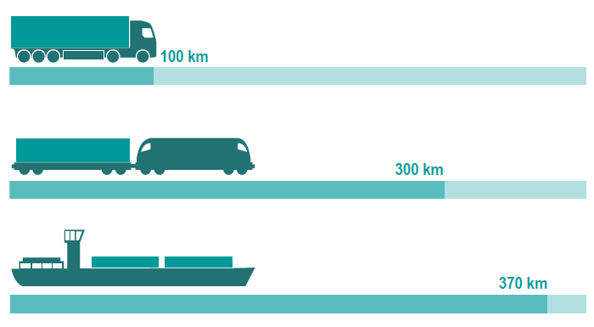
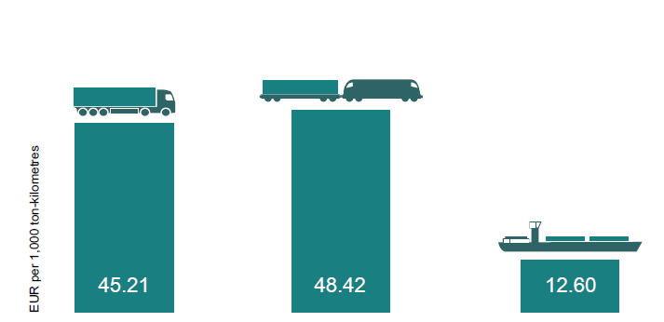
Ecological areas of influence
Specific energy consumption
Land consumption/ road costs
Source: PLANCO Consulting & Federal Institute of Hydrology 2007
Source: via donau
An inland waterway vessel can transport one tonne of cargo - almost four times as far as a lorry with the same energy consumption.
Improving the infrastructure of the entire Danube would cost around EUR 1.2 billion.
This corresponds to the construction costs of ONLY about 50 road kilometres.
Notes:
Land consumption / road costs
Infrastructure costs consist of the costs for the construction and maintenance of transport routes. Since in the case of inland waterways it is usually possible to fall back on a natural infrastructure, the cots for the infrastructure and land consumption are correspondingly low. Detailed comparisons with land transport modes in this respect are available from Germany: Accordingly, the infrastrcture costs per tonne-kilometre for rail or road are around four times higher than for waterways. According to current cost estimates for infrastructre projects in the neighbouring states, the improvement of the entire infrastructure of the almost 2,415 km long Danube waterway would amount to a total of EUR 1.2 billion. This corresponds roughly to the costs incurred for the construction of around 50 km of road or rail infrastrcture. Current European railway tunnel projects each costs around EUR 10 to 20 billion.
Specific energy consumption
In terms of specific energy consumption, inland navigation can be described as the most effective and therefore environmentally friendly mode of transport. The inland waterway vessel can transport one tonne of cargo almost four times as far as a truck with the same energy consumption.
Source:
Viadonau, „Handbuch der Donauschifffahrt“, p.18-20

Slide 15
Din Ecological influences
Din
Noise pollution mainly due to road →network density compared to rail and waterways
Railway noise in certain areas
Subjective perception
Hardly any noise pollution due to waterway
Source: https://pixabay.com/de/europa-karte-western-politischen-32847/c
Notes:
Due to the density of the network and the proximity to settlements and conurbations, noise pollution is mainly caused by roads. Railway noise affects the environment especially in certain areas, whereas freight traffic on waterways causes hardly any noise. Noise also depends on subjective perception - road noise is perceived as more disturbing than rail noise at the same noise level.
As the “Noise Viewer” of the Noise Observation and Information Service for Europe shows, the UK and Germany are particularly affected by road noise at night and during the day. In Austria, noise pollution from rail traffic is particularly noticeable during the day. In Italy and France, the majority of the population is affected by road and rail noise during the day and at night.
Sources:
Internationaler Eisenbahnverband (UIC), „Bahnlärm in Europa. Sachstandbericht 2010“ (2010). S.4f Online : http://www.uic.org/download.php/publication/516D.pdf [14.08.2015]
„Noise Viewer“, Online: http://noise.eionet.europa.eu/viewer.html [10.08.2016]

Slide 16
Social Influences
Traffic Safety
Inland waterway is safest compared to rail and truck
High Safety Standards
Low ultrasound costs
80% of transport of dangerous goods in Europe is carried out by inland waterway vessel
Working conditions
Inland waterway vessel: long stays on vessel → long working hours
Rail:
Shift operation → regulated working hours
Persons primarily in the afternoon → night work
Truck:
Long and irregular working hours
Deadline and time pressure→ Non-compliance with driving and rest periods
Long distance transport: absence from home
Notes:
Traffic Safety:
Compared to rail and road, inland waterway vessels can be described as the safest means of transport. This is made possible by high safety standards. This in turn has an impact on accident costs, which are comparatively low (see also external costs in comparison). For this reason, about 80% of all dangerous goods transports in Europe are carried out by inland waterway.
Working Conditions:
In inland navigation, long stays on the ship are not uncommon, which also means that a large part of the leisure time is spent on the ship.
With the railways there is often a 3-shift model which leads to regulated working hours. Since passenger transport is given priority during the day, most freight transport takes place at night, which in turn leads to night work.
Truck drivers are confronted with long and irregular working hours. In addition, the pressure of deadlines and time in the competition-driven industry means that driving times and rest periods are neglected. For long-distance drivers, the long absence from home is an additional factor.
Sources:
Krause, Alexandra, „Die Donau als Verkehrsweg.“ Das österreichische Verkehrsjournal, 3. Jahrgang, 02/2009, p.67
Online: http://www.verkehrsjournal.at/upload/pdf/%C3%96VJ_Feb2009_Krause.pdf [04.08.2016]
PLANCO Consulting GmbH/Bundesanstalt für Gewässerkunde, „Verkehrswirtschaftlicher und ökologischer Vergleich der Verkehrsträger Straße, Schiene und Wasserstraße“, (2007). p.17
Online : http://www.wsd-ost.wsv.de/service/Downloads/Verkehrstraegervergleich_Gutachten_komplett.pdf [04.08.2016]
Bundesamt für Güterverkehr (BAG), „Marktbeobachtung Güterverkehr. Auswertung der Arbeitsbedingungen in Güterverkehr und Logistik 2014-I“ (2014). p.9-10, 22, 33
Online: http://www.verkehrsrundschau.de/sixcms/media.php/4513/BAG-Bericht_5D_2014_Fahrzeugführer_2014.pdf [04.08.2016]

Slide 17
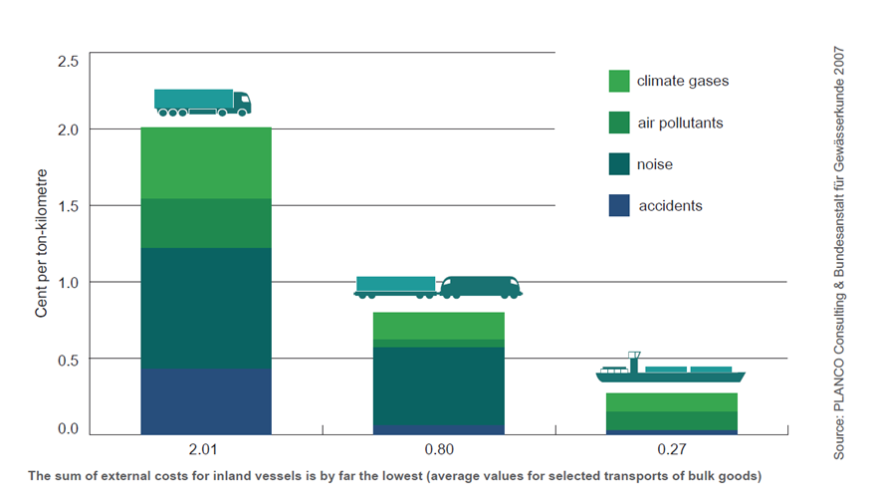
Economic Influences
Transport Costs
Most important factor in economic comparison
Influencing factors:
Transport quantity – capacity utilization
Distance of transport
Transported goods
Decreasing transport costs with increasing transport distance for all transport modes
Transport per tonne-kilometre by inland waterway is cheapest
Source: PLANCO Consulting & Bundesanstalt für Gewässerkunde 2007
Notes:
Transport costs:
Transport costs are one of the most important factors in an economic comparison. These are mainly influenced by the transport volume and thus the utilization of the transport modes, the transport distance and the type of goods transported. Basically, transport costs decrease with increasing transport distances for all transport modes. In terms of transport per tonne-kilometre, inland waterway transport is the cheapest transport mode compared with rail and road. The concrete costs of a transport route can, however, vary.
External costs:
The external costs, i.e. those resulting from climate gases, air pollutants, accidents and noise, are also lowest for inland waterway vessels. In particular, CO2 emissions are comparatively low, which means that inland navigation can make a contribution to achieving the European Union's climate goals.
Source:
PLANCO Consulting GmbH/Bundesanstalt für Gewässerkunde, „Verkehrswirtschaftlicher und ökologischer Vergleich der Verkehrsträger Straße, Schiene und Wasserstraße“, (2007). p. 29-41
Online : http://www.wsd-ost.wsv.de/service/Downloads/Verkehrstraegervergleich_Gutachten_komplett.pdf [04.08.2016]
Viadonau, „Handbuch der Donauschifffahrt“, p.18-20
Kille, Christian/ Schmidt , Norbert, „Wirtschaftliche Rahmenbedingungen des Güterverkehrs. Studie zum Vergleich der Verkehrsträger im Rahmen des Logistikprozesses in Deutschland“ (2008). P .22
Online: http://www.scs.fraunhofer.de/content/dam/scs/de/dokumente/studien/Wirtschaftliche_Rahmenbedingungen_des_Gueterverkehrs.pdf [04.08.2016]

Slide 18
Agenda Traffic and the environment and the contribution every individual can make
Traffic and Environment
Comparison of Transport Modes
Influencing Factor Society
Sustainable Transport Modes
Challenges for Sustainable Freight Transport

Slide 19
Transport Mode ‚Road‘ Comparison of Transport Modes
Transportation speed
Area coverage
Networking capability
Flexibility
Technical progress
Low utilization costs
Rising costs
Time restrictions → driving bans
Environmental aspects (CO2-emissions, din, accidents,…)
Notes:
The high transport speed compared to the rail and waterway transport modes can be cited as an advantage of road transport. Another strength is its coverage of the entire infrastructure and thus its ability to form a network (from door to door). Due to the wide range of different means of transport, this transport mode offers great flexibility. In addition, many IT solutions (e.g. tracking and tracing) are already widely used. In addition, the use of the instrastructure is associated with low costs (costs for road damage are only covered to a limited extent).
As the costs of congestion or din pollution (so-called external costs) are gaining more and more attention, the road is confronted with increasing cost pressure. The time restriction in the form of driving bans also has an impact on thre road as a transport mode. With regard to environmental aspects such as noise polluition or accidents, the road performs relatively poorly in comparison with other transport modes.
Sources:
Kille, Christian/ Schmidt , Norbert, „Wirtschaftliche Rahmenbedingungen des Güterverkehrs. Studie zum Vergleich der Verkehrsträger im Rahmen des Logistikprozesses in Deutschland“ (2008), p. 53
Online: http://www.scs.fraunhofer.de/content/dam/scs/de/dokumente/studien/Wirtschaftliche_Rahmenbedingungen_des_Gueterverkehrs.pdf [04.08.2016]
Viadonau, „Handbuch der Donauschifffahrt“, p. 19-21

Slide 20
Transport Mode ‚Rail‘ Comparison of Transport Mode
Speed
Mass efficiency
Predictability
Safety and security
Transportation price
Environmental aspects (CO2-Emissions)
Difficulty in crossing borders
Flexibility
Tracking and tracing
Energy costs
Notes:
Especially in the case of block trains or direct trains, rail cans score with a fast transport speed. In addition, the transport motde is mass-efficient and the transports are predictable. Due to standards, the safety level is very high. In contrast to road transport, transport prices are not influenced by tolls and can therefore be relatively favourable depending on the transported volume. The lower CO2 consumption compared to the road can also be mentioned as an advantage.
Due to infrastructural differences, cross-border transport by rail is still difficult. The dependence on timetables impairs the flexibility of the transports. Tracking shipments is also very difficult compared to road transport. Moreover, unlike air transport, rail transport does not enjoy any tax advantages.
Source:
Kille, Christian/ Schmidt , Norbert, „Wirtschaftliche Rahmenbedingungen des Güterverkehrs. Studie zum Vergleich der Verkehrsträger im Rahmen des Logistikprozesses in Deutschland“ (2008), p. 54
Online: http://www.scs.fraunhofer.de/content/dam/scs/de/dokumente/studien/Wirtschaftliche_Rahmenbedingungen_des_Gueterverkehrs.pdf [04.08.2016]

Slide 21
Transport Mode ‚Inland Waterway‘ Comparison of Transport Mode
Low transport costs
Mass Efficiency
Environmental friendliness
Saftey and security
Transport fequency – 24hours operational readiness
Low infrastructure costs
Dependency on fairway conditions
Low transport speed
Low network density – necessity of pre/post-travel
Notes:
Above all the strengths of Danube navigation are in its ability to transport large quantities per ship unit, its favourable tansport costs and its environmental friendliness. In addition, it can be used around the clock (e.g. no weekend or night driving ban) and has a high level of safety and low infrastructure costs.
The weaknesses lie in the dependency on fluctuating fairway conditions and the associated varying degree of utilisation of the ships, the low transport speed and the low network density, which often require a pre- and post-carriage by road or rail.
Source:
viadonau, „Handbuch der Donauschifffahrt“, p.19

Slide 22
Advantages of the Combination of Transport Modes
Utilization of specific advantages of transport modes
Minimization of disadvantages ot the transport modes
Transport Mode | Strenghts | Wekanesses
Road | High network density Speed of short transport distances | Low transport volumes High external costs
Rail | Low environmental impact (CO2, pollutants, din) More dense network (comparison of waterways) Low-cost & fast on medium transport routes | Low network density than the road
Inland Waterway | Low transport costs and low negative effects at high volumes | Transportation time Network density
Notes:
By combining the transport modes, the specific advantages of the individual modes can be exploited and disadvantages of these minimized.
Due to the high network density and the speed of short transport distances, road transport is particularly suitable for the pre- and post-carriage of multimodal transports. Due to the low environmental impact and the relatively low transport costs of rail and waterway for medium and long distances and high volumes, these two transport modes are suitable for the main run in multimodal transport. By bundling freight transports, approproate transport volumes can be achieved that justify transport with these transport modes from an economic point of view.
Sources:
BMVIT, Rechnungshof; „Bericht des Rechnungshof: Nachhaltiger Güterverkehr – Intermodale Vernetzung” (2012), p.260
Online: http://www.rechnungshof.gv.at/fileadmin/downloads/2012/berichte/teilberichte/bund/Bund_2012_05/Bund_2012_05_4.pdf [05.08.2016]

Slide 23
Agenda Traffic and the environment and the contribution every individual can make
Traffic and Environment
Comparison of Transport Modes
Influencing Factor Society
Sustainable Transport Modes
Challenges for Sustainable Freight Transport

Slide 24
Spheres of influence in Freight Traffic
Environment: Society – Economy - Politics
Offer of Freight Transport
Infrastructure
New Technologies
Demand on Freight Transport
Company
Free Capacities
Competition
Distribution Strategy
Traffic Distribution
Procurement Strategy
Modal Split*
Areas of Tension
Freight Companies
Clients
* Share of respective transport modes in total freight transport volume
Notes:
The modal split mainly depends on the supply and the demand of freight transport. On the supply side, the following areas of influence can be identified: Existing infrastructure, new technologies, free capacities and competition on the market.
In addition, society, the economy and politics determine the freight transport environment. The demand for goods is primarily determined by the procurement and distribution strategy of the companies. The choice of transport modes by companies also has a significant impact on the volume of freight traffic. This can lead to tensions between the freight companies and the customers, as both parties may have different transport requirements. For example, freight companies aim to maximize transport capacity utilisation, while customers want fast delivery times and low transport costs.
In summary, it can be stated, that freight transport depends on many different factors, which, in turn, influence each other. For this reason, different starting points and challenges also arise for the sustainable orientation of freight transport.
Source:
Holderied, Cornelius: Güterverkehr, Spedition und Logistik. Managementkonzepte für Güterverkehrsbetriebe, Speditionsunternehmen und logistische Dienstleister, München, 2005 p.17-34

Slide 25
Challenges for Sustainable Freight Transport
Use of new technologies
Choice of transport depending on goods
Value of goods
Time factor
Trends towards individualization → increasing transport volume
Rail
Passenger transport has priority
Fewer innovations
Need for reverse logistics (recycling, waste management)
Local disposal decreases
Notes:
Various challenges can be identified in the course of implementing sustainable freight transport:
The use of new technologies, for example, is not yet possile in the commercial sense.
The choice of transport highly depends on the value of thetransported goods as well as on the transport time. Due to the cost advantages of truck transport, it is still frequently used as a means of transport.
The trend away from mass production towards indiviualization leads to an increase in shipments and a further increase in transport volumes.
The railways have the disadvantage that the passenger traffic is often treated preferentially and less innovations are available in the technical area. This makes this transport moed less attractive as an alternative to trucks.
As local disposal is decreasing, the need for „revers logistics“ for recycling processes or in the course of waste management has led to a higher transport volume.
Source:
Institute for Transport Studies, “Die Zukunft der Nachhaltigkeit in Güterverkehr und Logistik” (2010). p.15
Online: http://www.europarl.europa.eu/RegData/etudes/note/join/2010/431578/IPOL-TRAN_NT(2010)431578_DE.pdf [05.08.2016]

Slide 26
Promotion of Sustainable Freight Transport
Transportation costs
Alternative fuels
Traffic shift
Improvement of existing means of transport or development of new means of transport
Combination of transport modes
Information and Communication Technologies (ICT)
New business models
Notes:
There are different ways of promoting sustainable freight transport. Since the choice of transport mode strongly depends on transport prices, a new pricing policy in the transport sector could help to increase the use of sustainable transport modes.
The development and use of alternative fuels could also lead to more sustainable freight transport. As mentioned at the beginning of the presentation, modal shift is also seen as an appropriate measure to promote sustainable freight transport. By shifting from road to rail or waterway, the environmental impact has to be reduced.
With regard to the means of transport, improving existing means of transport in terms of size, wight or capacity and fuel consumption can be useful in order to achieve sustainable freight transport in the long term. According to the requirements of transported good the development of new means of transport would also be a possible solution (e.g. self-propelled means of transport).
An efficient combinaton of existing transport modes can also reduce environmental impacts. Through the use of information and communication technologies (ICT), transports can be planned more efficiently and better, which could, for example, reduce empty journeys or efficently utilize transport capacity. Finally, the development of new business models can also lead to freight transport becoming more sustainable. By focusing on local production and sales, for example, long transport distances could be reduced.
Source:
Institute for Transport Studies, “Die Zukunft der Nachhaltigkeit in Güterverkehr und Logistik” (2010). p. 21-26
Online: http://www.europarl.europa.eu/RegData/etudes/note/join/2010/431578/IPOL-TRAN_NT(2010)431578_DE.pdf [05.08.2016]

Slide 27
Best Practice Examples Sustainable Freight Transport
DHL GoGreen
Compenstaion of CO2 emissions caused by transport
Send „Climate neutral“ for an extra charge
Investment in climate protection projects
Grüne Erde
All consigments are delivered CO2 neutral → CO2 emissions are compensated by supporting climate protection projects
2014: 85,800 consignments (letters, advertising, parcels) were delivered in a CO2 neutral way
ImagineCargo
Use of rail and cycle courier service for express delivery in Austria, Germany, Switzerland
Can be used by private individuals and companies
Notes:
Some logistics service providers already offer the possibility of sending goods in an environmentally friendly way. As part of the DHL GoGreen initiative, DHL offers the option of climate-neutral shipment at a surcharge. The proceeds are then invested in climate protection projects to compensate for the CO2 emissions caused by the transport.
The company „Grüne Erde“, which sells ecologically and fairly manufactured products, also ships all shipments CO2 neutral by compensating the CO2 emissions caused by the transport by investing in climate protection projects. In 2014, for example, 85,8000 items (letters, advertising and parcels) were delivered CO2 neutral.
The start-up company „ImagineCargo“ offers customers (private or corporate) the opportunity to send items such as letters or parcels in an environmentally friendly manner. The railway is used and cycle couriers are used to transport the consignments from the sender to the recipient.
Sources:
URL: http://www.dhl.de/de/paket/information/privatkunden/gogreen-klimafreundlicher-versand.html [10.08.2016]
URL: http://www.grueneerde.com/de/produkte/zertifizierte-zustellung.html?3 [10.08.2016]
URL: http://www.imaginecargo.com/ [10.08.2016]

Slide 28
Agenda Traffic and the environment and the contribution every individual can make
Traffic and Environment
Comparison of Transport Modes
Influencing Factor Society
Sustainable Transport Modes
Challenges for Sustainable Freight Transport

Slide 29
The Influence of Society on Freight Transport
Society or customers as a decisive factor in freight transport → Consumer behaviour
Growing demand for sustainable products and services
Green transport capacity is preferred to cheaper transport capacity
Willingness to pay
Offer of sustainable transport services is expected
https://pixabay.com/de/person-silhouetten-menschen-540261/
Notes:
As already mentioned, social trends and demands have a decisive influence on freight transport. Basically, an increased demand for sustainable products (e.g. in the food sector) can be identified. In addition, the underlying processes are being viewed more critically by consumers, which also increases the demand for sustainable services such as transport.
As the online survey „Green Trend Survey“, which was conducted by Deutsche Post DHL in the course of the trand study „Delivering Tomorrow: Customer Expectations in 2020 and Beyond“, shows in 2012, consumers are prepared to prefer sustainable transport services to cheaper transport services. In addition, there is a fundamental willingness to pay more for this sustainable transport service. Nevertheless, the majority of consumers expect that sustainable transport services should in principle be offered in the future without paying an additonal price. Sind consumer behaviour also has an influence on freight transport, the next slides compare stationary and online purchases.
Source: Deutsche Post AG, “Delivering Tomorrow. Logistik 2050 Eine Szenariostudie“ (2012). p. 42ff
Online: http://www.dpdhl.com/content/dam/dpdhl/logistik_populaer/trends/StudieSustainableLogistics/dpdhl_delivering_tomorrow_studie.pdf [05.08.2016]

Slide 30
Social Perception Influencing Factor ‚Society‘
Train and ship are preceived as sustainable transport modes → train as a suitable transport alternative
52 % of consumers would be willing to pay more for sustainable transport
Source: PwC Survey (2008)
Notes:
As part of a study implemented by PricewaterhouseCoopers, 500 people were asked, whereas 86% perceive rail as an environmentally friendly means of transport. The majority of respondents perceived the truck as not environmentally friendly and would see the train in particular as a suitable transport alternative. In addition, more than half of the respondents are prepared to pay more for sustainable transport alternative. In addition, more than half of the respondents are prepared to pay more for sustainable transport – between 5 and 20%.
Thus, from a social point of view, the ship and the train are preceived above all as sustainable transport modes.
Source:
PricewaterhouseCoopers, “The truck industry's green challenge. Headwind or copmpetitive edge?” (2008). p. 45-46. Online: http://www.pwc.be/en_BE/be/transport-logistics/pdf/Truck-industry-s-green-challenge-2008-09-23.pdf [04.08.2016]

Slide 31
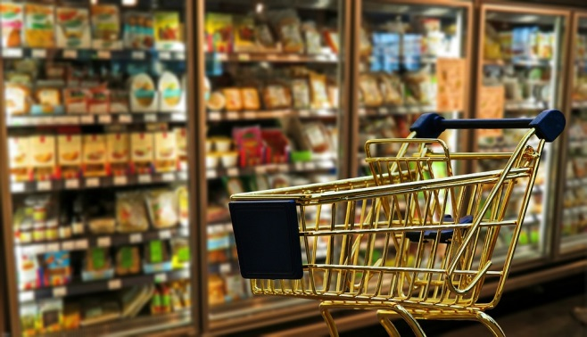
Consumer Behaviour in Society
Online Shopping
Stationary Purchase
Definition (e-Commerce): „business transaciton or electronically conducted business process in which participants…are not in direct physical contact“
Advantages for consumers:
Cost saving
Time & comfort
Entertainment
Definition (stationärer Handel): Purchas in shops, at fixed locations
Advantages for consumers:
Quality control
Personal approach - consultation
Social contacts
https://pixabay.com/de/einkaufen-gesch%C3%A4ft-einzelhandel-1165437/
Quelle: https://pixabay.com/de/einkaufswagen-internet-warenkorb-728407//
Notes:
An online purchase, also known as e-commerce, is a business transaction or an electronically processed busines sprocess in which the persons involved are not in pdirect physical contact. The online purchaase is mainly associated with 3 advantages: Cost savings can be achieved by comparing the products. The possibility of free delivery is also attractive for consumers. In addition, online trading is not bound to business hours, so access is possible at any time. For the younger consumer group, online retailing also offers a certain entertainment value.
Stationary purchase or stationary retailing refers to purchasing in stores that have a fixed location. The advantages of stationary retail are that the consumer can convince herself/himself of the quality of the product and, if necessary, also take advantage of advice. Social contacts can also be maintained.
Sources:
URL: http://wirtschaftslexikon.gabler.de/Definition/e-commerce.html [11.08.2016 ]
URL: http://wirtschaftslexikon.gabler.de/Definition/stationaerer-handel.html [11.08.2016]
Deutsches CleanTechInstitut (DCTI), „ Klimafreundlich einkaufen. Eine vergleichende Betrachtung von Onlinehandel und stationärem Einzelhandel“ (2015), p.38ff
Online: http://www.dcti.de/fileadmin/pdfs_dcti/DCTI_Studien/Studie_Klimafreundlich_Einkaufen_WEB.pdf [11.08.2016]

Slide 32
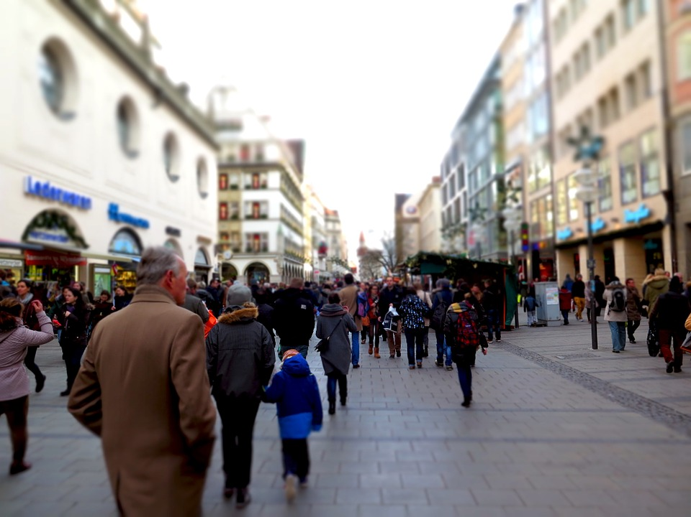
Stationary Purchase
Properties of Transport Process
More bundling opportunities through delivery to the shop
Fewer transport services on the part of entrepreneurs
CO2 emissions:
Small items (e.g. mobile phone): 450g
Large items (e.g. couch): 8,4 kg
Individual transport performance is necessary → majority with the car
Source: https://pixabay.com/de/einkaufsstra%C3%9Fe-get%C3%BCmmel-shopping-579079/
Notes:
The transport processes in stationary purchasing are characterized by the fact that companies have more bundling options for a delivery to a shop. In addition, by avoiding transport to individual end customers, fewer transport services are provided by the companies compared with online trading. The customer himself is therefore responsible for the „last mile“ and thus for collecting the products from the shop.
The CO2 emission with the purchase of a small article (e.g. mobile phone) is at about 450g, the CO2 emission with the purchase of large article (e.g. couch) is at 8.4 kg. A large proportion of CO2 emissions are caused by the individual transport services required to get to the store. In addition, the distance to the shop is usually covered by car. Lower values may be possible when choosing public transport or other means of transport.
Source:
Deutsches CleanTechInstitut (DCTI), „ Klimafreundlich einkaufen. Eine vergleichende Betrachtung von Onlinehandel und stationärem Einzelhandel“ (2015), p. 23ff Online: http://www.dcti.de/fileadmin/pdfs_dcti/DCTI_Studien/Studie_Klimafreundlich_Einkaufen_WEB.pdf
“Studie: Online-Handel klimafreundlicher als stationärer Handel”. Online: https://www.onlinehaendler-news.de/handel/studien/19828-online-handel-klimafreundlich.html [04.08.2016]

Slide 33
Online Shopping
Properties of the Transport Process
Several transshipment processed (warehouse – hub – delivery to the customer)
Fewer bundling options through indiviual orders
Flexible route planning is necessary
Increased return of goods → Zalando: 50 %
Less individual transport services (shipments can be collected - around 97,4 shipments per tour)
CO2 emissions:
Small items (e.g. mobile phone): 310g → -35 % compared to the stationary purchase
Large items (e.g. couch): 8,0 kg
Co2 Output depending on the Shipping Method
Express delivery
Parcel station
Home
Quelle: https://pixabay.com/de/einkaufswagen-internet-warenkorb-728407//
Notes:
Several handling processes are associated with online purchasing: The goods are usually transported from the warehouse to the transhipment points and then, depending on the geographical location of the customers, are distributed to further distribution centres before they are transported to the customer. Individual orders such as express orders mean that companies have fewer bundling options for shipments. Therefore, flexible route planning is necessary to meet these requirements. In online trading, there is also an increase in returns – the return rate for Zalando, for example, is 50%. Nevertheless, online trading requires fewer or shorter individual transport services on the part of the customer than stationary trading, as consignments are delivered collectively.
The CO2 emission when shipping a small item such as a mobile phone is 310 g – minus 35% compared to a stationary purchase. For large items, the value amounts to approximately 8 kg. The advantage of online purchasing is that the transport services can be bundled and thus the transports can be used relatively efficiently. In one tour, for example, approximately 97.4 broadcasts are combined.
However, CO2 emissions are very dependent on the shipping method:
If express delivery is chosen, transport must be organized more quickly, which reduces the possibility of bundling.
When delivering to a parcel station, the customer has to cover the last mile herself/himself, which in turn results in CO2 emissions due to the individual transport service.
In case of home delivery, there is the possiblity that the customer is not present, which may require further delivery attempts or shipping to a parcel station.
Sources:
Deutsches CleanTechInstitut (DCTI), „ Klimafreundlich einkaufen. Eine vergleichende Betrachtung von Onlinehandel und stationärem Einzelhandel“ (2015), p.23ff
Online: http://www.dcti.de/fileadmin/pdfs_dcti/DCTI_Studien/Studie_Klimafreundlich_Einkaufen_WEB.pdf
“Studie: Online-Handel klimafreundlicher als stationärer Handel”. Online: https://www.onlinehaendler-news.de/handel/studien/19828-online-handel-klimafreundlich.html [04.08.2016]
„Ist Online-Shopping schlecht?“. URL: http://www.jetzt.de/lexikon/ist-online-shopping-schlecht-582714 [04.08.2016]

Slide 34
Measures to create a sustainable purchase Company and Politics
Online Shopping
Stationary Purchase
Reduction of the rate of returns
Improvement of the item description
Minimization of delivery attempts
Offering a time window for delivery
Use of environmentally friendly vehicles
Sustainable design of mobility concepts
Improvement of infrastructure
Enable the switch to public transport
New sales concept
Combination of stationary and online retail (e.g. click & collect – order online and pick up at the store)
Notes:
Various measures can be identified on the part of companies and politicians in order to make purchasing in online trade and stationary trade more sustainable:
In online trading, a reduction in the rate of returns can be achieved with the help of a more precise description of the items. Additional transport routes can be avoided by minimizing delivery attempts in the course of optimized customer agreement or efficient time window delivery. Logistics companies can also reduce CO2 emissions by using enivornmentally friendly vehicles (e.g. hybrid drive). Through the development of sustainable mobility concepts, such as distribution concepts in conurbations like cities, CO2 savings can be realized.
On behalf of politics a possible measure for eco-friendlier purchase could be, that in stationary trade, the infrastructure is improved to enable the switch to alternative means of transport such as bicycles or public transport. By combining different sales channels (online, stationary), retailers can develop new concepts and thus promote CO2-conscious purchasing behavour among consumers. With the click & collect concept, for example, customers can order products online and pick them up from the company‘s store, thus optimizing sales channels.
Sources:
“Studie: Online-Handel klimafreundlicher als stationärer Handel”. Online: https://www.onlinehaendler-news.de/handel/studien/19828-online-handel-klimafreundlich.html [04.08.2016]
Ritter, Helmut; „Multichannel: Digitale (R)Evolution im Handel - Qualitative Studie im Auftrag von Handelsverband und Google Austria GmbH“,(2013), p. 5f. Online: https://www.handelsverband.at/fileadmin/content/pdf/Studie_Multichannel_2013.pdf [10.08.2016]

Slide 35
Measures to create a sustainable purchase Consumer
Online Shopping
Stationary Purchase
Shipping Method
Avoid express deliveries
Receiving goods cellectively
Minimization of the rate of returns
Read product descriptions and customer recessions
Minimization of delivery attempts
Use parcel tracking
Request for delivery to the workplace
Choose a parcel station which in on the way to the work
Selection of Transport Mode
Public transport (urban area)
Minimize individual transport routes
Product Choice
Regional products → shorter transportatoin routes
Selction of sustainable products → pay attention to the product label
Notes:
Consumers can also take various measures to make shopping in online and stationary retail more sustainable:
By choosing the shipping type, the consumer can already influence the transport volume. By avoiding express deliveries and dispatching the goods in a collective delivery, companies can take advantage of bundling effects. When buying, consumers can use the product descriptions and customer recessions to avoid ordering unnecessarily many products, most of which are returned. Particularly in the textile sector, different sizes are often ordered from the same article, so the return rate is very high. The number of delivery attempts can also be influenced by the consumer: By using parcel tracking, the dav of delivery can be better estimated ensuring that you are at home for delivery. It is also possible to deliver parcels to the workplace or to choose delivery to a parcel statoin on the daily route to work, thus avoiding additional individual transport routes by car.
In the stationary retail, indiviual CO2 emissions can be reduced by swithcing to public transport or alternative means of transport such as bicycles. When using a car, the transport routes should be minimized in order to keep the indiviual transport performance as low as possible (e.g. searching for a central car park and shopping in foot). In addition, the choice of sustainable products such as fairtrade products or regional products can ensure that the transport route of the consumed goods is as short as possible.
Sources:
“Studie: Online-Handel klimafreundlicher als stationärer Handel”. Online: https://www.onlinehaendler-news.de/handel/studien/19828-online-handel-klimafreundlich.html [04.08.2016]
„Warum Anprobieren besser ist als Onlineshopping“. URL: http://www.tagesspiegel.de/wirtschaft/umweltbelastung-durch-zalando-und-co-warum-anprobieren-besser-ist-als-onlineshopping/9486812.html [10.08.2016]
URL: http://www.nachhaltig-einkaufen.de/ [10.08.2016]

Slide 36
Sources
Eurostat, „Greenhouse gas emission statistics“, (2016), Online: http://ec.europa.eu/eurostat/statistics-explained/index.php/Greenhouse_gas_emission_statistics [05.08.2016]
Whiteing Anthony; „Die Zukunft der Nachhaltigkeit in Güterverkehr und Logistik“ (2010), Online: http://www.europarl.europa.eu/RegData/etudes/note/join/2010/431578/IPOL-TRAN_NT(2010)431578_DE.pdf [26.07.2016]
International Transport Forum, “Reducing Transport Greenhouse Gas Emissions. Trends & Data 2010.”, (2010), Online: http://www.itf-oecd.org/sites/default/files/docs/10ghgtrends.pdf [05.08.2016]
European Commission, “Weissbuch - Fahrplan zu einem einheitlichen europäischen Verkehrsraum – Hin zu einem wettbewerbsorientierten und ressourcenschonenden Verkehrssystem” (2011), Online: http://eur-lex.europa.eu/legal-content/de/TXT/PDF/?uri=CELEX:52011DC0144 [05.08.2016]
Bretzke, Wolf-Rüdiger/Karmin Barkawi: Nachhaltige Logistik: Antworten auf eine globale Herausforderung. Berlin Heidelberg, 2010
Kudla, Nicole: Nachhaltigkeitsmanagement, in: Fagagnini Hans Peter/Stöltzle Wolfgang (Hrsg.): Güterverkehr kompakt, 2010
Saroha Rituraj: Green Logistics & its Significance in Modern Day Systems, in: International Review of Applied Engineering Research 4, 1/2014, S.89-92. Online unter: http://www.ripublication.com/iraer-spl/iraerv4n1spl_14.pdf
Transportation Research Board of the National Academies, “The Value of Freight: Introduction to the Role of Freight Transportation” (2011), Online: http://www.envisionfreight.com/value/index.html%3Fid=introduction.html [03.08.2016]
„Synchromodality“ (2013), Online: https://www.youtube.com/watch?v=5ofhMxRRyec [03.08.2016]
„Green Marketing – Green Logistics – Fact or Fad?“ (2014), Online: https://www.youtube.com/watch?v=xUF9C10DPrg [05.08.2016]
Pazirandeh, Ali/Jafari, Hamid: Making sense of green logistics, in: International Journal of Productivity and Performance Management, 62, 8/2013, S.889-904
Federal Environment Agency (UBA), “Daten zum Verkehr – Ausgabe 2012”. (2012)Online : https://www.Federal Environment Agency.de/sites/default/files/medien/publikation/long/4364.pdf [04.08.2016]
European Commission, „Mitteilung der Kommission an das europäische Parlament, den Rat, den europäischen Wirtschafts- und Sozialausschuss und den Committee of the Regions. Mehr Qualität in der Binnenschifffahrt“ (2013). Online : http://ec.europa.eu/transport/modes/inland/promotion/doc/naiades2/com(2013)623_de.pdf [04.08.2016]
Via donau, „Handbuch der Donauschifffahrt“ (2013), Download: http://www.viadonau.org/de/newsroom/publikationen/handbuch-der-donauschifffahrt/
Internationaler Eisenbahnverband (UIC), „Bahnlärm in Europa. Sachstandbericht 2010“ (2010). Online : http://www.uic.org/download.php/publication/516D.pdf [14.08.2015]
PLANCO Consulting GmbH/Bundesanstalt für Gewässerkunde, „Verkehrswirtschaftlicher und ökologischer Vergleich der Verkehrsträger Straße, Schiene und Wasserstraße“, (2007). Online : http://www.wsd-ost.wsv.de/service/Downloads/Verkehrstraegervergleich_Gutachten_komplett.pdf [04.08.2016]
Bmvit, „Faktenblatt. Gesamtverkehrsplan für Österreich. Immissionsschutzgesetz Luft (IG-L) Maßnahmen zum Schutz vor Immissionen durch Luftschadstoffe“ (2012), Online: https://www.bmvit.gv.at/verkehr/gesamtverkehr/gvp/faktenblaetter/umwelt/fb_immissionsschutzg_luft.pdf [10.08.2016]
Nehm, Alexander, „Nachhaltigkeitsindex für Logistikdienstleister. Orientierungshilfe in einem transparenten Markt“ (2011), Online: http://media.havi-logistics.com/Top_Navigation/News_Basics/News/German/_attachment/Fraunhofer_SCS_-_Nachhaltigkeitsindex_für_Logistikdienstleister_Mai_2011.pdf [10.08.2016]
„Noise Viewer“, Online: http://noise.eionet.europa.eu/viewer.html [10.08.2016]

Slide 37
Sources
Krause, Alexandra, „Die Donau als Verkehrsweg.“ Das österreichische Verkehrsjournal, 3. volume, 02/2009, p. 58-80, Online: http://www.verkehrsjournal.at/upload/pdf/%C3%96VJ_Feb2009_Krause.pdf [04.08.2016]
Federal Office for Freight Transport (BAG), „Marktbeobachtung Güerverkehr. Auswertung der Arbeitsbedingungen in Güterverkehr und Logistik 2014-I“ (2014). Online: http://www.verkehrsrundschau.de/sixcms/media.php/4513/BAG-Bericht_5D_2014_Fahrzeugführer_2014.pdf [04.08.2016]
Kille, Christian/ Schmidt , Norbert, „Wirtschaftliche Rahmenbedingungen des Güterverkehrs. Studie zum Vergleich der Verkehrsträger im Rahmen des Logistikprozesses in Deutschland“ (2008). Online: http://www.scs.fraunhofer.de/content/dam/scs/de/dokumente/studien/Wirtschaftliche_Rahmenbedingungen_des_Gueterverkehrs.pdf [04.08.2016]
PricewaterhouseCoopers, “The truck industry's green challenge. Headwind or copmpetitive edge?” (2008).Online: http://www.pwc.be/en_BE/be/transport-logistics/pdf/Truck-industry-s-green-challenge-2008-09-23.pdf [04.08.2016]
BMVIT, Court of Auditors; „Bericht des Rechnungshof: Nachhaltiger Güterverkehr – Intermodale Vernetzung” (2012), Online: http://www.rechnungshof.gv.at/fileadmin/downloads/2012/berichte/teilberichte/bund/Bund_2012_05/Bund_2012_05_4.pdf [05.08.2016]
Deutsche Post AG, “Delivering Tomorrow. Logistik 2050 Eine Szenariostudie“ (2012). Online: http://www.dpdhl.com/content/dam/dpdhl/logistik_populaer/trends/StudieSustainableLogistics/dpdhl_delivering_tomorrow_studie.pdf [05.08.2016]
Deutsches CleanTechInstitut (DCTI), „ Klimafreundlich einkaufen. Eine vergleichende Betrachtung von Onlinehandel und stationärem Einzelhandel“ (2015), Online: http://www.dcti.de/fileadmin/pdfs_dcti/DCTI_Studien/Studie_Klimafreundlich_Einkaufen_WEB.pdf
“Studie: Online-Handel klimafreundlicher als stationärer Handel”. Online: https://www.onlinehaendler-news.de/handel/studien/19828-online-handel-klimafreundlich.html [04.08.2016]
„Ist Online-Shopping schlecht?“. Online: http://www.jetzt.de/lexikon/ist-online-shopping-schlecht-582714 [04.08.2016]
Holderied, Cornelius: Güterverkehr, Spedition und Logistik. Managementkonzepte für Güterverkehrsbetriebe, Speditionsunternehmen und logistische Dienstleister, München, 2005
Institute for Transport Studies, “Die Zukunft der Nachhaltigkeit in Güterverkehr und Logistik” (2010). Online: http://www.europarl.europa.eu/RegData/etudes/note/join/2010/431578/IPOL-TRAN_NT(2010)431578_DE.pdf [05.08.2016]
European Commission, “EU energy, transport and GHG emissions - Trends to 2050 Reference Scenario 2013” (2013), Online: http://ec.europa.eu/transport/media/publications/doc/trends-to-2050-update-2013.pdf 09.08.2016]
International Transport Forum/ OECD, “ITF Transport Outlook 2015”, (2015), Online: http://www.oecd-ilibrary.org/docserver/download/7414021e.pdf?expires=1457012730&id=id&accname=ocid56027859&checksum=F3F96F396835D30F46A01AD6921DC83C [09.08.2016]
Consent Markt- und Sozialforschung: Imageanalyse FRIENDS on the road (2014), Online: https://www.wko.at/Content.Node/iv/presse/wkoe_presse/presseaussendungen/Studie__FriendsOnTheRoad_Transpoteure_pwk_116_022014.pdf [09.08.2016]
Wutke, Sebastian, „Nachhaltigkeit in der Logistik - Relevanz und Entwicklungen in der Praxis“ (2013), Online : http://www.logistik.din.de/sixcms_upload/media/3820/Präsentation_Wutke.pdf [05.08.2015]
Ritter, Helmut; „Multichannel: Digitale (R)Evolution im Handel - Qualitative Studie im Auftrag von Handelsverband und Google Austria GmbH“,(2013), Online: https://www.handelsverband.at/fileadmin/content/pdf/Studie_Multichannel_2013.pdf [10.08.2016]
„Warum Anprobieren besser ist als Onlineshopping“. Online: http://www.tagesspiegel.de/wirtschaft/umweltbelastung-durch-zalando-und-co-warum-anprobieren-besser-ist-als-onlineshopping/9486812.html [10.08.2016]
Website: http://www.nachhaltig-einkaufen.de/ [10.08.2016]
URL: http://wirtschaftslexikon.gabler.de/Definition/e-commerce.html [11.08.2016 ]
URL: http://wirtschaftslexikon.gabler.de/Definition/stationaerer-handel.html [11.08.2016]

Slide 38
Additional Information
We hope our slide set meets your requirements!
- Your are welcome to adapt the slide set according to your wishes and requirements and use it for your lessons/lectures.
For questions and feedback please contact our research team.
alexandra.haller@fh-steyr.at or lisa-maria.putz@fh-steyr.at are at your disposal.
You can find further slide sets here:
http://www.reecotrans.at/en/teaching-materials/bundles/
If you are interested in our Transport School Lab or a guest lecture have a look at:
http://www.reecotrans.at/en/services/

